Slide 1
Fundamentals of Google Calendar - Part 1
Core Features Overview
Google Calendar offers essential tools that streamline scheduling and enhance productivity in business environments. Understanding these features helps optimize daily operations and time management.
• Create and organize events with customizable details.
• Set reminders and notifications to stay on track.
• Share calendars with team members for better coordination.
• Integrate with other Google Workspace applications seamlessly.
• Access calendars across multiple devices anytime, anywhere.
Google Calendar’s intuitive interface allows quick event creation, timely alerts, and easy sharing. These features collectively support effective time management and collaboration in professional settings.
Mastering the basic functions of Google Calendar empowers businesses to manage appointments efficiently and improve communication among teams. These foundational capabilities support better planning, reduce scheduling conflicts, and enhance overall workflow.

Slide 2
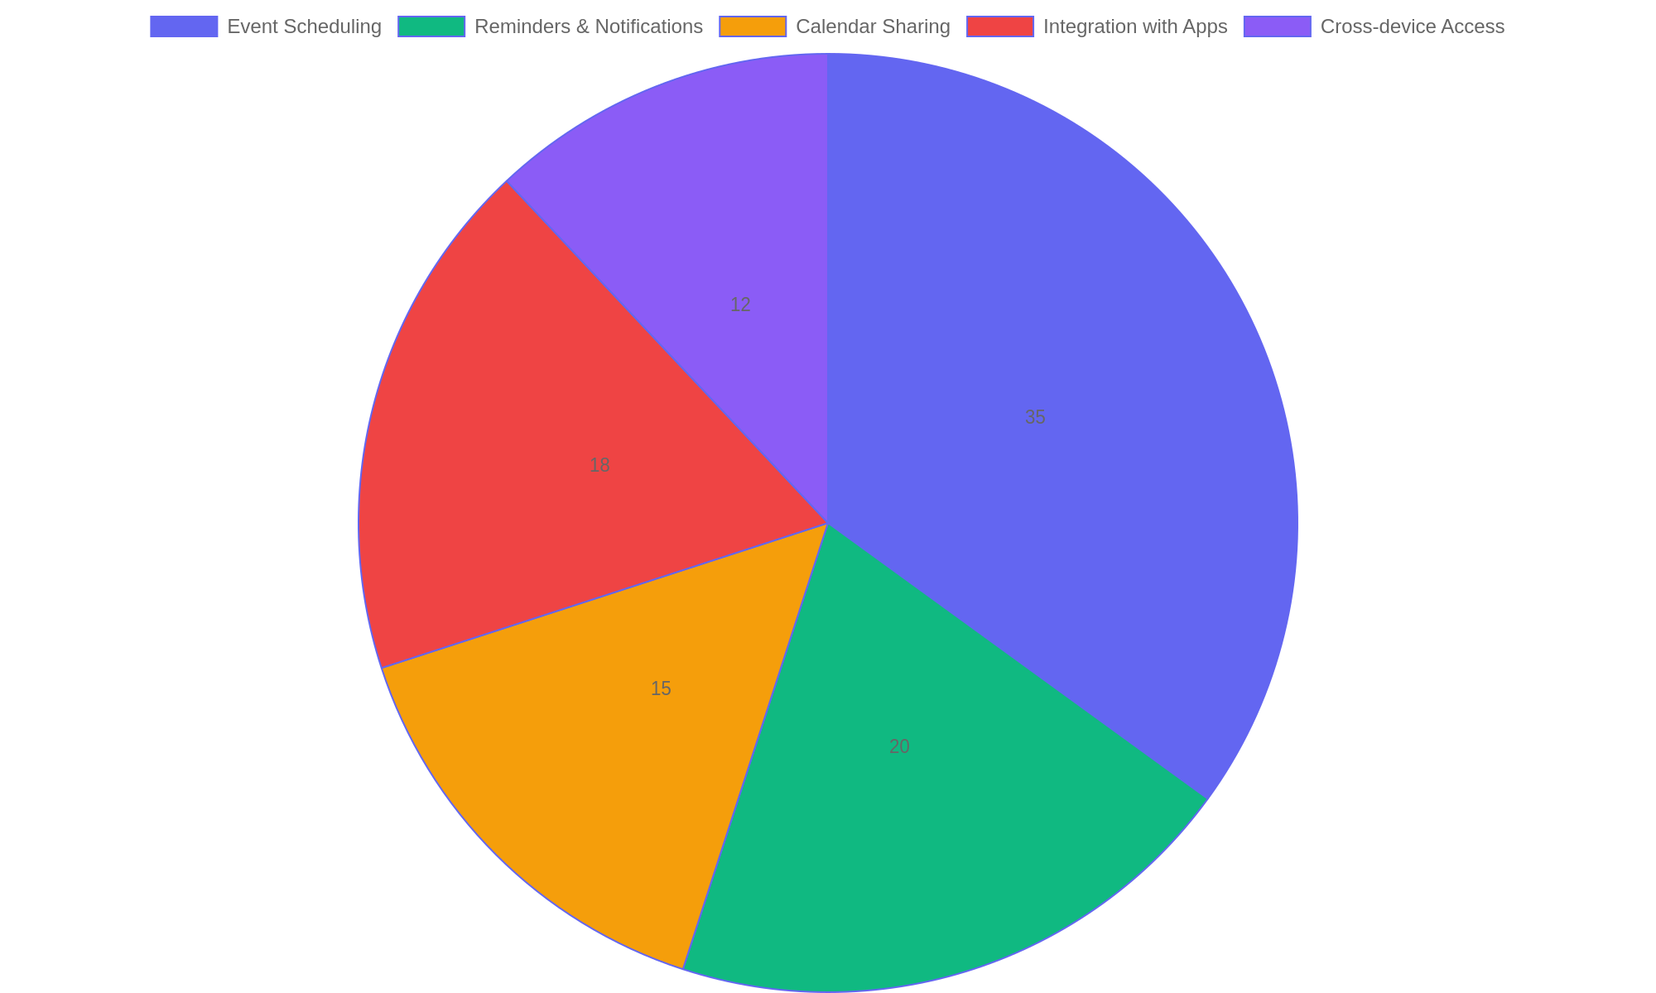
Usage Distribution of Google Calendar Features in Business
This pie chart illustrates the relative frequency of key Google Calendar features used by businesses to enhance productivity and coordination.

Slide 3
Event Creation and Management - Part 1
Core Functions of Event Setup
Mastering event creation in Google Calendar involves setting clear details, adjusting timing, and specifying locations. Efficient management includes editing events and categorizing them for easy access. These skills help maintain a structured schedule and improve team collaboration.
• Create events by entering titles, dates, and times.
• Add locations and descriptions to provide context.
• Use color-coding to organize events by category or priority.
• Edit events anytime to update details or reschedule.
• Delete or duplicate events to manage your calendar efficiently.
Effective event management starts with precise creation, including all necessary information. Utilizing editing options and visual organization tools like color labels enhances clarity and adaptability for busy schedules.
Creating and managing events in Google Calendar requires attention to detail and flexibility. By customizing event attributes such as timing, location, and descriptions, users can build a clear and organized schedule. Color-coding and editing features support ongoing adjustments, ensuring that calendars remain accurate and relevant for individual and team use.

Slide 4
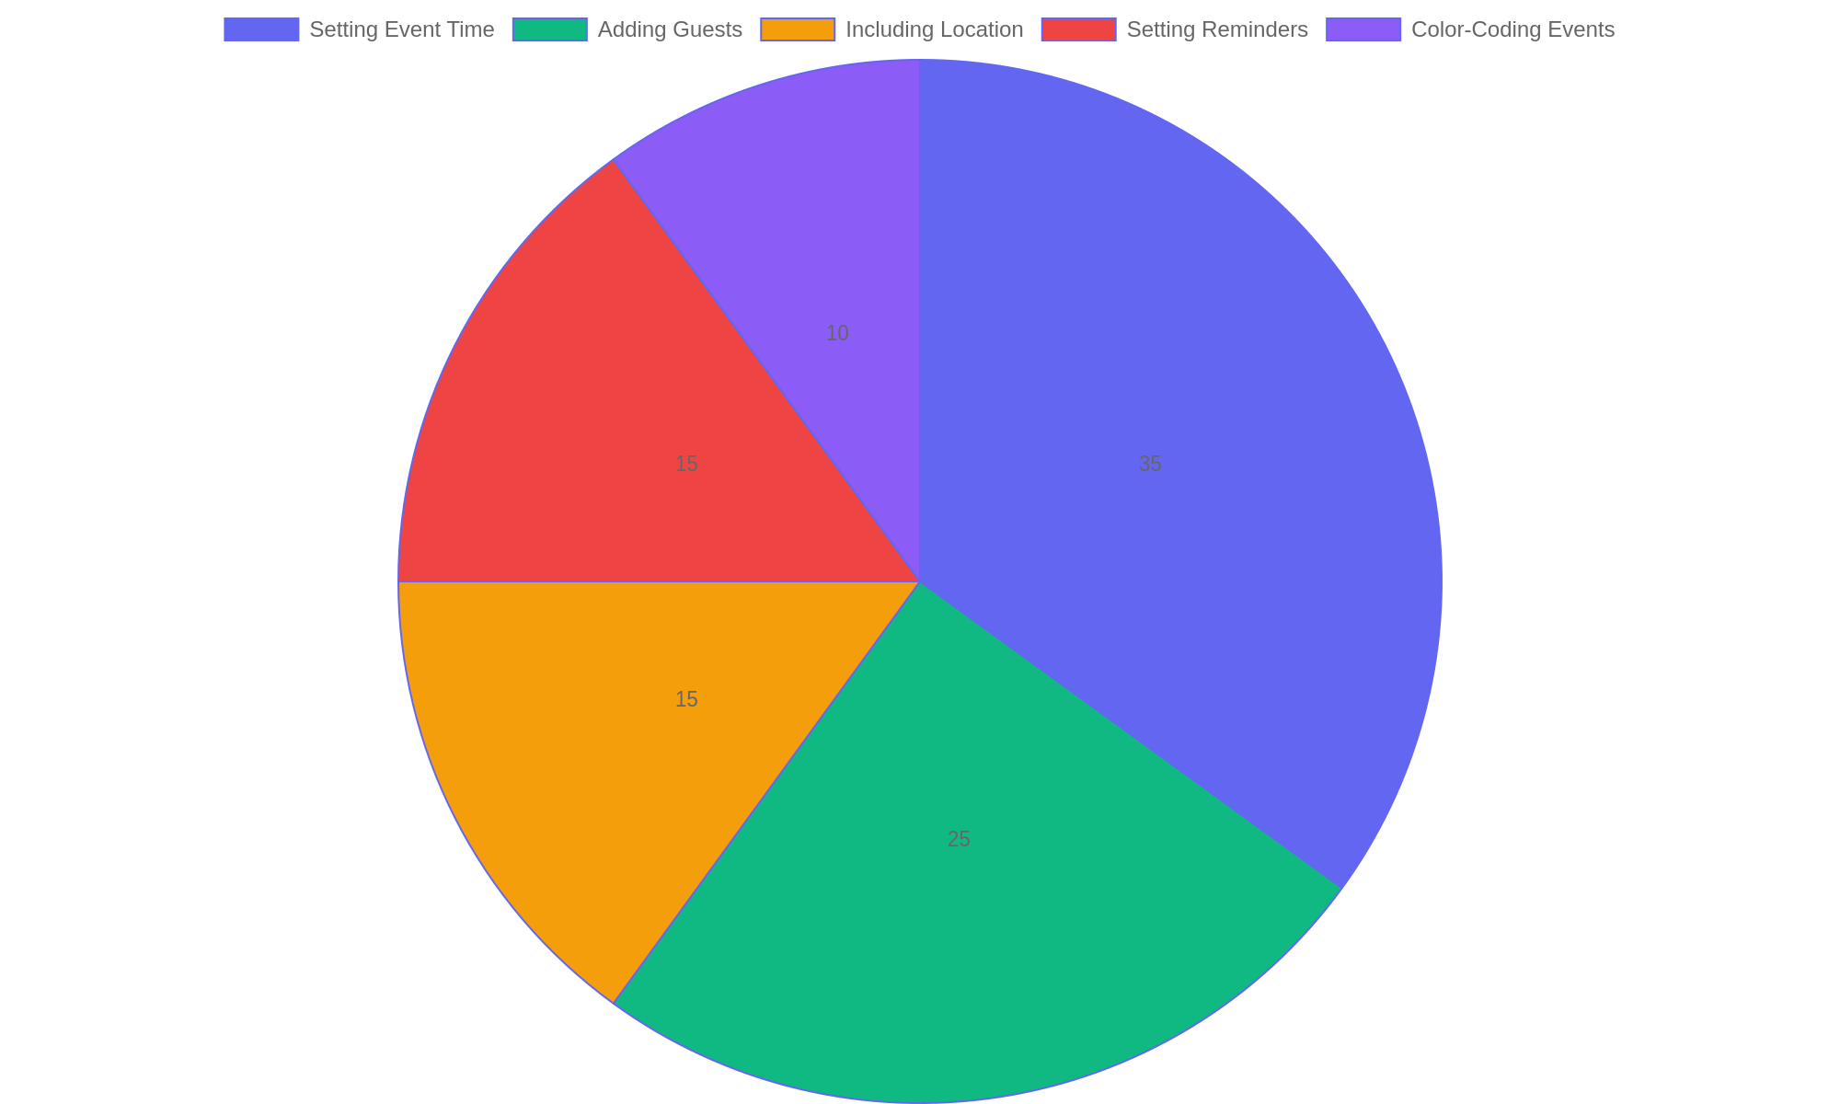
Common Features Used in Google Calendar Events
Distribution of frequently utilized features during event creation and management, highlighting time setting and guest invitations as the most common.

Slide 5
Organizing with Multiple Calendars
Purpose and Benefits
Using multiple calendars within Google Calendar allows businesses to separate different types of activities, improving organization and reducing scheduling conflicts. This approach supports clear categorization and easier management of diverse tasks and events.
• Create distinct calendars for projects, teams, or event types.
• Assign unique colors to each calendar for quick visual identification.
• Toggle calendar visibility to focus on specific activities when needed.
• Share individual calendars with relevant team members to control access.
• Integrate calendars to view combined schedules without losing clarity.
Setting up multiple calendars enables clear separation of business activities. Assign colors and share calendars selectively to improve focus and collaboration. This organization method minimizes overlaps and helps maintain a structured workflow across different projects or departments.
Multiple calendars help businesses streamline scheduling by categorizing events and tasks into separate, manageable streams. This method enhances clarity and collaboration, allowing users to view or hide calendars based on immediate priorities. Color-coding and sharing options add flexibility, enabling teams to stay coordinated without overwhelming the main calendar view.

Slide 6
Collaborative Calendar Sharing
Sharing Calendars for Team Efficiency
Google Calendar enables seamless collaboration by allowing users to share calendars with team members. This feature supports assigning different permission levels, ensuring appropriate access and control. Collaborative scheduling reduces conflicts, improves transparency, and streamlines planning for business activities.
• Share calendars with specific individuals or groups to enhance coordination.
• Assign access levels: view only, make changes, or manage sharing settings.
• Use calendar overlays to view multiple schedules simultaneously.
• Set notifications for shared events to keep everyone informed.
• Leverage shared calendars for project timelines and resource booking.
Sharing calendars with tailored permissions empowers teams to coordinate efficiently. Users can view availability, propose meeting times, and track shared events, which simplifies managing collective schedules and enhances productivity.
Collaborative calendar sharing is essential for effective teamwork. By customizing access permissions, teams can maintain privacy while promoting transparency. This approach helps synchronize schedules, avoid overlaps, and improve communication. Utilizing Google Calendar's sharing options fosters a cooperative environment where everyone stays aligned with business priorities and deadlines.

Slide 7
Integrations for Enhanced Functionality
Maximizing Productivity with Seamless Connections
Integrating Google Calendar with complementary business applications streamlines workflows and boosts efficiency. By linking scheduling tools with communication platforms, email services, and task management systems, teams can coordinate more effectively and reduce manual entry errors.
• Connect Google Calendar with Google Meet for instant video conferencing links.
• Synchronize calendar events with email platforms to receive timely notifications.
• Integrate project management apps to align deadlines and milestones directly within the calendar.
• Use third-party automation tools to create custom workflows between Google Calendar and other services.
• Enable calendar sharing and permissions to facilitate transparent team scheduling.
Google Calendar’s integration capabilities allow users to embed video meetings, sync notifications, and track project timelines in one place. This interconnected approach simplifies planning, minimizes scheduling conflicts, and supports a cohesive digital workspace.
Linking Google Calendar with various business tools enhances operational efficiency by centralizing scheduling and communication. These integrations reduce redundant tasks, improve collaboration, and ensure that important meetings and deadlines are automatically reflected across platforms. Such connectivity empowers teams to stay organized and responsive in dynamic work environments.

Slide 8
Utilizing Advanced Features
Unlocking Google Calendar's Full Potential
Explore how advanced functionalities like color-coding events, attaching relevant files, and setting personalized notifications can streamline your scheduling process and enhance productivity.
• Apply color labels to categorize events for quick visual reference.
• Attach documents, spreadsheets, or presentations directly to calendar events.
• Customize notification settings to receive timely reminders via email or pop-ups.
• Use multiple notification methods to ensure no important event is missed.
• Leverage event descriptions and notes for detailed context within appointments.
Advanced Google Calendar tools allow users to visually organize events with colors, link relevant files for easy access, and customize reminders to fit personal or team preferences. These features help maintain clarity and punctuality in busy business environments.
Mastering Google Calendar’s advanced features empowers users to organize their schedules more effectively. By utilizing color-coding, attaching files, and fine-tuning notifications, businesses can reduce missed appointments, improve collaboration, and maintain a clear overview of daily tasks. These tools offer a tailored calendar experience that adapts to various workflows and communication styles, ultimately boosting operational efficiency.

Slide 9
Effective Calendar Practices in Business
Optimizing Time and Meetings
Implementing strategic calendar habits enhances productivity and streamlines collaboration in business environments. Effective calendar management supports prioritization, reduces scheduling conflicts, and fosters clear communication among team members.
• Block dedicated time for focused work to minimize distractions.
• Use descriptive titles and agenda notes for all calendar events.
• Set realistic meeting durations and avoid overbooking.
• Leverage color-coding to categorize tasks and meetings visually.
• Regularly review and adjust calendar entries to reflect changing priorities.
Effective calendar use involves clear labeling, appropriate time blocking, and consistent updates. Prioritizing tasks and meetings through calendar management helps prevent conflicts and promotes efficient use of working hours.
Mastering calendar practices tailored for business needs enables professionals to manage their time efficiently and coordinate meetings effectively. By organizing events with clarity and purpose, teams can reduce overlap and enhance productivity. Adopting these habits leads to better time allocation, improved communication, and smoother workflow across departments.

Slide 10
Recap and Future Learning Pathways
Summary of Key Concepts
This segment consolidates the core techniques and strategies explored for maximizing Google Calendar’s potential in a business environment. It also highlights next steps to deepen your expertise and integrate advanced functionalities into your daily workflow.
• Mastered event creation, modification, and sharing for team coordination.
• Utilized reminders and notifications to boost productivity and punctuality.
• Leveraged calendar integrations with other business tools for seamless operations.
• Explored customization options to tailor calendar views and settings.
• Identified resources and learning paths to continue skill development.
This recap emphasizes practical usage and encourages continuous learning through specialized resources, enabling users to adapt Google Calendar to evolving business needs and optimize time management.
By reviewing the essential features and practical applications of Google Calendar, you are now equipped to improve scheduling efficiency and team collaboration. To further enhance your proficiency, consider exploring advanced tutorials, community forums, and official Google updates that provide ongoing insights and new capabilities.

