Slide 1
Foundations of Ethical Tax Preparation - Part 1
Core Principles of Ethical Conduct
Ethical tax preparation requires a commitment to transparency, accuracy, and respect for legal standards. Practitioners must prioritize honesty in reporting, ensure clients fully understand their obligations, and recognize the serious consequences of cutting corners or misrepresenting information.
• Honesty is the cornerstone of trustworthy tax preparation.
• Complete disclosure prevents misunderstandings and legal issues.
• Ethical behavior fosters client confidence and professional reputation.
• Noncompliance or deception can result in severe penalties.
• Maintaining integrity supports the overall tax system’s fairness.
Ethical tax preparation depends on transparent communication and truthful reporting. Tax preparers must avoid shortcuts that compromise accuracy. Upholding integrity ensures compliance and preserves the public’s trust in the tax process.
This section highlights the essential ethical foundations necessary for responsible tax preparation. Emphasizing honesty and full disclosure, it explains how ethical conduct not only protects clients but also upholds the credibility of the tax profession. Understanding the risks associated with unethical actions reinforces the importance of adhering to these principles consistently.

Slide 2
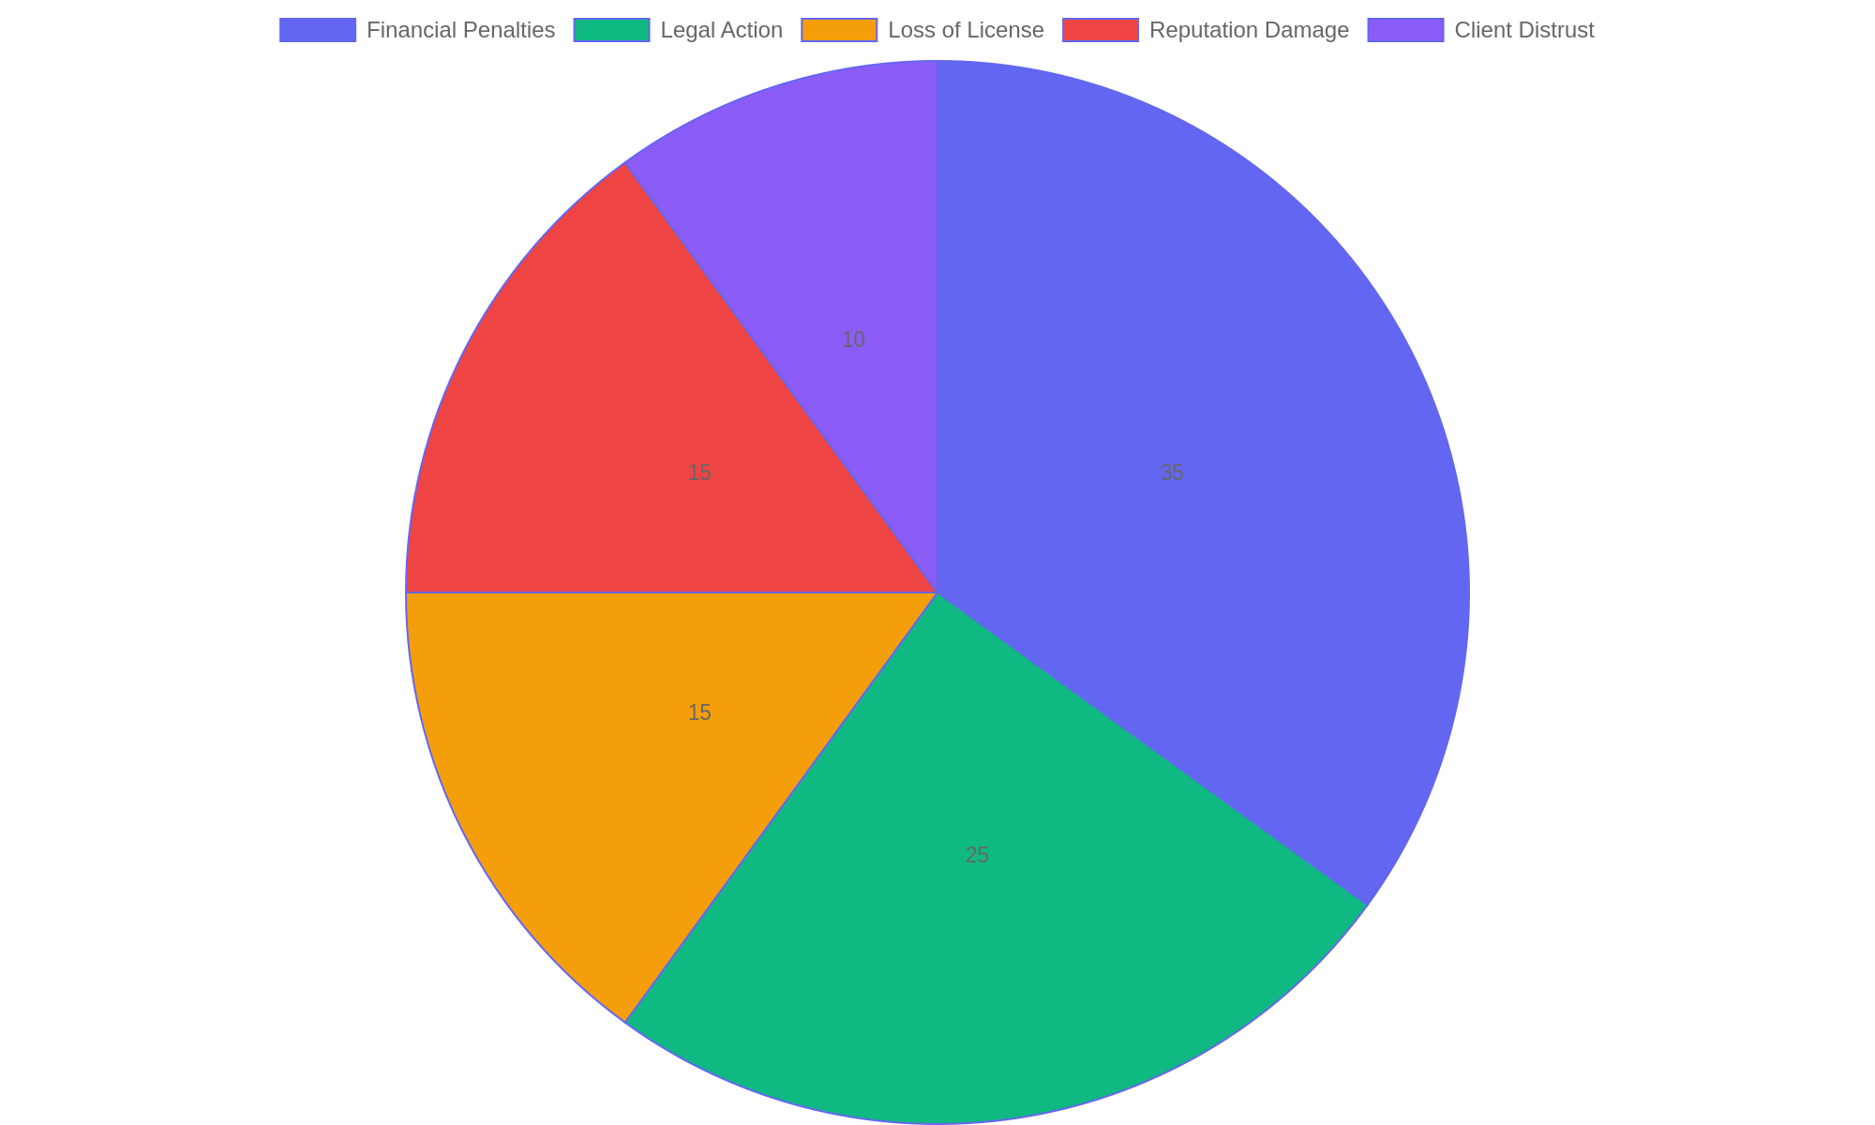
Common Consequences of Unethical Tax Practices
Distribution of typical repercussions faced by tax preparers engaging in unethical behavior, illustrating the broad impact on professional and personal standing.

Slide 3
Identifying Ethical Breaches - Part 1
Common Ethical Violations in Tax Preparation
This slide highlights key ethical breaches frequently encountered in tax preparation, focusing on how these actions undermine trust and legal compliance.
• Manipulating financial data to reduce taxable income.
• Misrepresenting income sources or amounts on returns.
• Omitting required disclosures to conceal information.
• Using fraudulent deductions or credits without basis.
• Failing to maintain confidentiality of client information.
Tax preparers must avoid altering client data, misreporting income, or neglecting mandatory disclosures. Such actions compromise ethical standards and can lead to serious consequences for both preparers and clients.
Ethical breaches in tax preparation often involve deliberate alterations or omissions that distort a taxpayer’s true financial situation. These violations not only risk legal penalties but also damage the reputation of professionals involved. Understanding these common breaches helps in recognizing warning signs and promoting integrity in tax services.

Slide 4
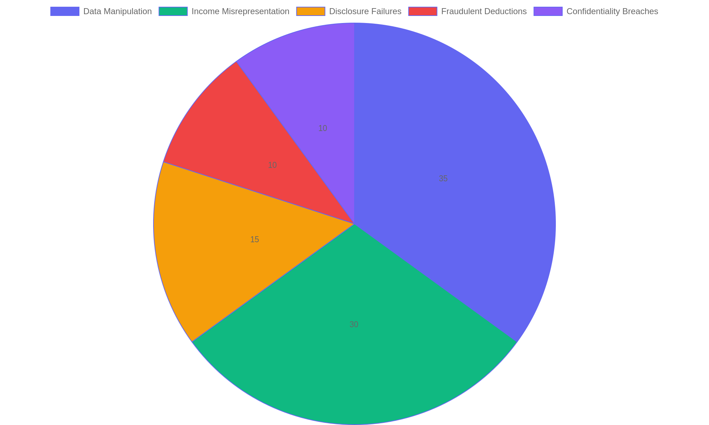
Distribution of Ethical Violations in Tax Preparation
Proportional representation of common ethical violations found in tax preparation cases.

Slide 5
Analyses of High-Profile Tax Scandals - Part 1
Major Cases and Underlying Causes
This slide explores significant tax scandals involving preparers who faced legal action due to unethical conduct. It highlights the behaviors and decisions that triggered investigations and penalties, emphasizing lessons learned for compliance and ethical responsibility.
• Misrepresentation of client income and deductions as a frequent violation.
• Use of fraudulent documentation to reduce tax liabilities.
• Failure to adhere to regulatory standards and reporting requirements.
• Conflicts of interest and concealment of personal gains.
• Inadequate internal controls and oversight enabling misconduct.
Examining cases reveals patterns of deceit such as falsifying income and deductions, which breach tax laws. These actions compromise the integrity of the tax system and highlight the necessity for rigorous ethical compliance among preparers.
High-profile tax scandals often stem from deliberate misrepresentation and manipulation of financial information by tax preparers. These unethical actions result in severe legal consequences, including fines and imprisonment. Understanding the root causes of these scandals helps professionals identify red flags and reinforces the importance of ethical standards in tax preparation.

Slide 6
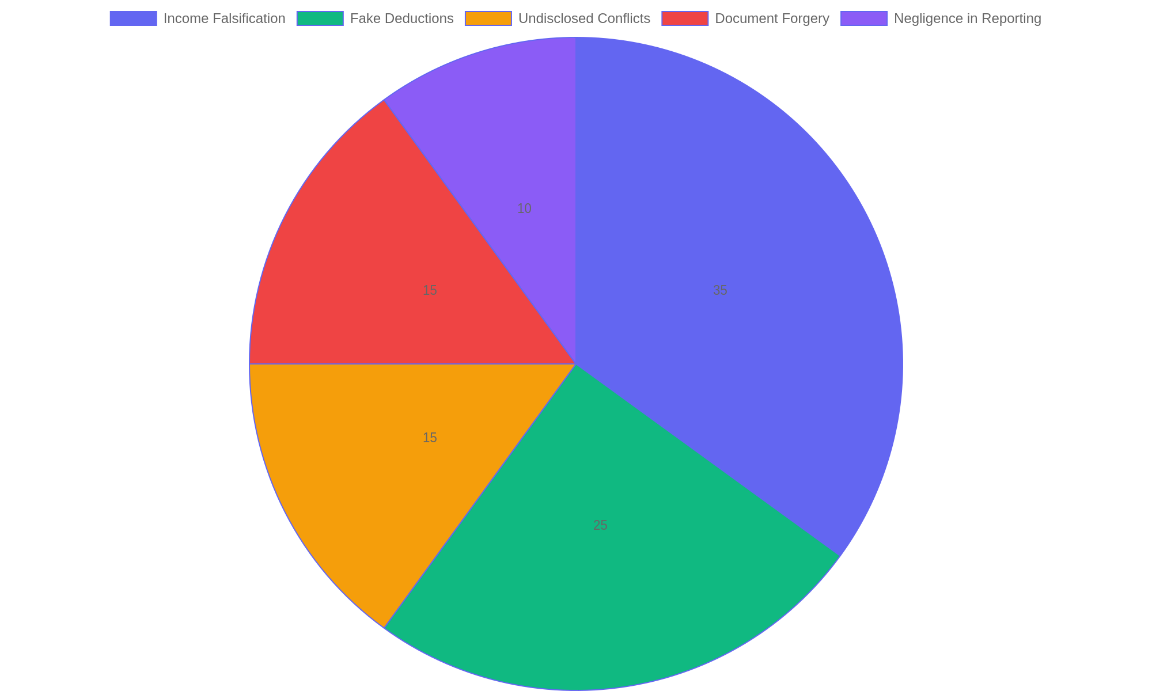
Common Unethical Practices by Tax Preparers
Distribution of unethical behaviors identified in major tax scandal investigations involving preparers.

Slide 7
Establishing Ethical Standards
Key Strategies for Ethical Tax Preparation
Implementing strong ethical standards is essential for maintaining trust and professionalism in tax preparation. This involves continuous education, legal adherence, and creating a culture where accountability is prioritized to prevent misconduct and ensure client confidence.
• Commit to ongoing education and ethics training for all preparers.
• Strictly comply with current tax laws and regulations.
• Develop clear policies outlining ethical expectations and consequences.
• Encourage open communication to report unethical behavior safely.
• Foster a workplace culture that values transparency and responsibility.
Ethical tax preparation depends on continuous learning, adherence to legal requirements, and a supportive culture that encourages responsibility. Clear policies and safe channels for reporting misconduct are vital for sustaining integrity and professionalism in the field.
Upholding ethical standards in tax preparation requires deliberate actions such as regular training to stay informed on laws, establishing explicit ethical guidelines, and promoting accountability. These measures help create a professional environment where integrity is prioritized, reducing risks of malpractice and enhancing client trust in the services provided.

Slide 8
Navigating the Regulatory Environment
Understanding Compliance and Consequences
This segment explores the essential regulations that govern tax preparation professionals. It outlines the legal framework, emphasizing the importance of adherence to rules and the repercussions of non-compliance for both tax preparers and their clients.
• Overview of key tax preparation laws and standards
• Common regulatory requirements for tax preparers
• Potential penalties for violations, including fines and sanctions
• Impact of regulatory breaches on client trust and professional reputation
• Best practices to maintain compliance and avoid legal issues
Tax preparation is governed by detailed regulations that demand accuracy and ethical conduct. Failure to comply can lead to penalties affecting both the preparer and client. Staying informed and adhering to these rules helps maintain professional integrity and client confidence.
Tax preparers operate within a structured regulatory environment designed to protect taxpayers and ensure accuracy. Violations can result in severe penalties such as monetary fines, suspension of licenses, or legal action. Understanding these rules not only safeguards the preparer’s career but also protects clients from financial and legal harm. Proactive compliance is critical to sustaining ethical and effective tax services.

Slide 9
Reflections and Key Insights
Ethical Foundations and Public Trust
This segment synthesizes the core lessons on ethical conduct in tax preparation, emphasizing the vital responsibility tax professionals hold in upholding honesty and transparency to foster confidence among clients and the broader community.
• Ethical behavior is the cornerstone of credible tax preparation services.
• Maintaining transparency prevents misunderstandings and legal risks.
• Tax preparers influence public trust through consistent integrity.
• Professional accountability strengthens the reputation of the tax industry.
• Ongoing education supports adherence to evolving ethical standards.
The role of tax preparers extends beyond number crunching; it demands unwavering ethical commitment. Upholding transparency and accountability ensures that public trust remains intact, which is essential for a fair and reliable tax system.
Tax preparers occupy a critical position where ethical decisions directly impact public confidence and financial fairness. By embracing transparency, accountability, and continual learning, tax professionals reinforce their role as trusted advisors. This reflection highlights how ethical vigilance not only protects clients but also elevates the entire profession’s integrity in a complex regulatory environment.

