Slide 1
Introduction to Email Challenges - Part 1
Common Email Obstacles
Understanding the typical problems users face with email helps identify why inboxes become cluttered and productivity drops. This slide outlines the key challenges that contribute to email overload and stress.
• Excessive volume of incoming messages
• Difficulty prioritizing urgent versus non-urgent emails
• Frequent interruptions disrupting workflow
• Unclear or poorly structured email content
• Lack of consistent email management habits
Many users face inbox overload due to high email volume and unclear priorities. Interruptions and inconsistent handling worsen the problem, making it essential to identify these factors for better management.
Email challenges often stem from the sheer number of messages received daily and the struggle to distinguish important communications from less critical ones. These issues cause distractions and delay responses, ultimately reducing efficiency. Recognizing these obstacles is the first step to developing healthier email practices and regaining control over digital communication.

Slide 2
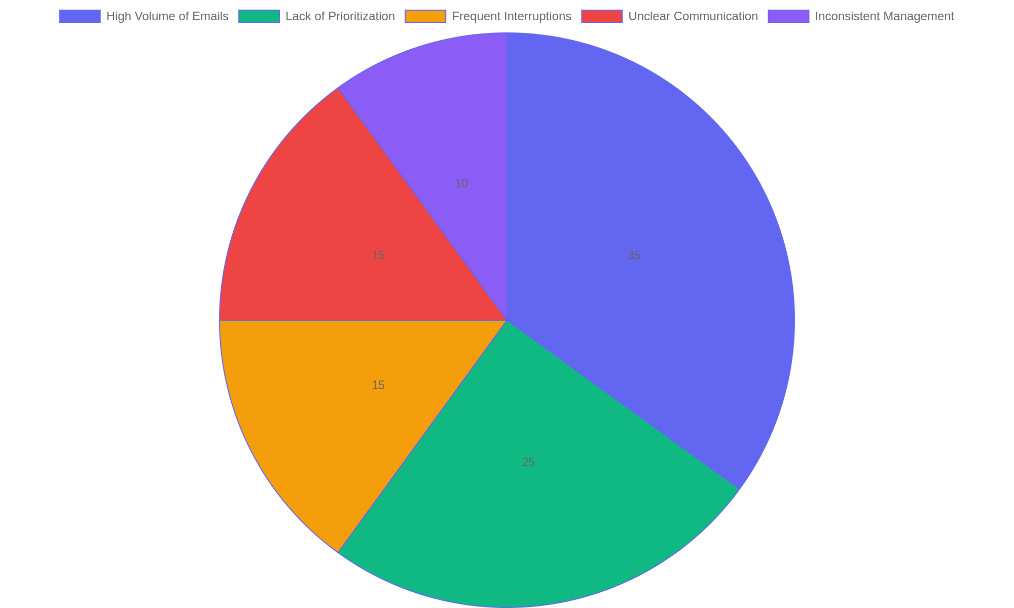
Primary Causes of Email Overwhelm
Distribution of factors contributing to email overload based on user surveys.

Slide 3
Introduction to Email Challenges - Part 3
Self-Assessment and Improvement
Evaluating personal email habits reveals specific areas where improvements can increase productivity and reduce stress. This slide guides learners to reflect on their behaviors and identify actionable steps.
• Frequency of checking email during work hours
• Methods used to organize and archive messages
• Response time to incoming emails
• Strategies for managing email interruptions
• Use of tools or filters to streamline inbox
Reviewing email habits like checking frequency and organization methods helps uncover inefficiencies. Adjusting these behaviors leads to improved focus and less inbox stress.
Self-assessment empowers individuals to understand how their email routines affect daily output. By pinpointing inefficient habits, learners can adopt targeted strategies such as scheduled email checks or better categorization to enhance focus and reduce overwhelm.

Slide 4
Organizational Strategies for Email - Part 1
Structuring Your Email Workflow
Effective email management begins with a clear, organized system. By categorizing emails and prioritizing tasks, you can reduce clutter and respond efficiently. This approach helps maintain focus and ensures important messages receive timely attention.
• Create distinct categories for work, personal, and informational emails.
• Use filters to automatically sort incoming messages into relevant folders.
• Flag or mark emails that require immediate action to prioritize responses.
• Schedule regular times to review and process non-urgent emails.
• Archive or delete emails once addressed to keep the inbox manageable.
Developing a streamlined email system includes categorizing messages, applying filters for automatic sorting, and prioritizing urgent communications. Regularly processing non-urgent emails and clearing out handled messages keeps your inbox focused and efficient.
Organizing your email involves setting up clear categories and using filtering tools to automate sorting. Prioritizing urgent messages and scheduling dedicated time for less critical emails helps maintain control over your inbox. This structured process minimizes distractions and improves response efficiency, leading to better time management and reduced email-related stress.

Slide 5
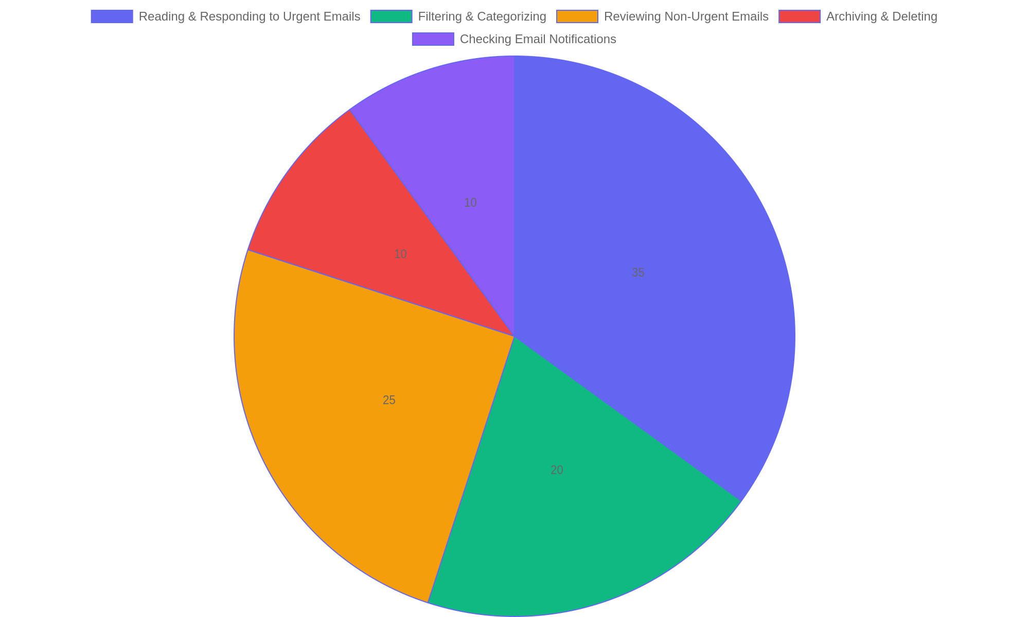
Time Allocation for Email Management Tasks
Distribution of time spent on different email management activities to optimize workflow.

Slide 6
Communicating Effectively via Email - Part 1
Core Principles for Impactful Emails
Mastering email communication requires focusing on clarity, brevity, and purpose. Crafting messages that are straightforward and easy to understand enhances reader engagement and response rates.
• Use clear and concise language to avoid confusion.
• Keep emails brief, focusing only on essential information.
• Create subject lines that summarize the email’s purpose.
• Make requests direct and easy to act upon.
• Organize content logically with short paragraphs or bullet points.
Successful emails combine clear wording with focused content, ensuring readers grasp the message without extra effort. Strong subject lines and actionable requests improve response rates and foster better communication.
Effective email communication hinges on delivering messages that are straightforward and purposeful. By emphasizing clarity and brevity, writers can ensure their emails are read and understood quickly. Crafting engaging subject lines captures attention, while direct requests guide recipients toward desired actions, making email exchanges more productive and efficient.

Slide 7
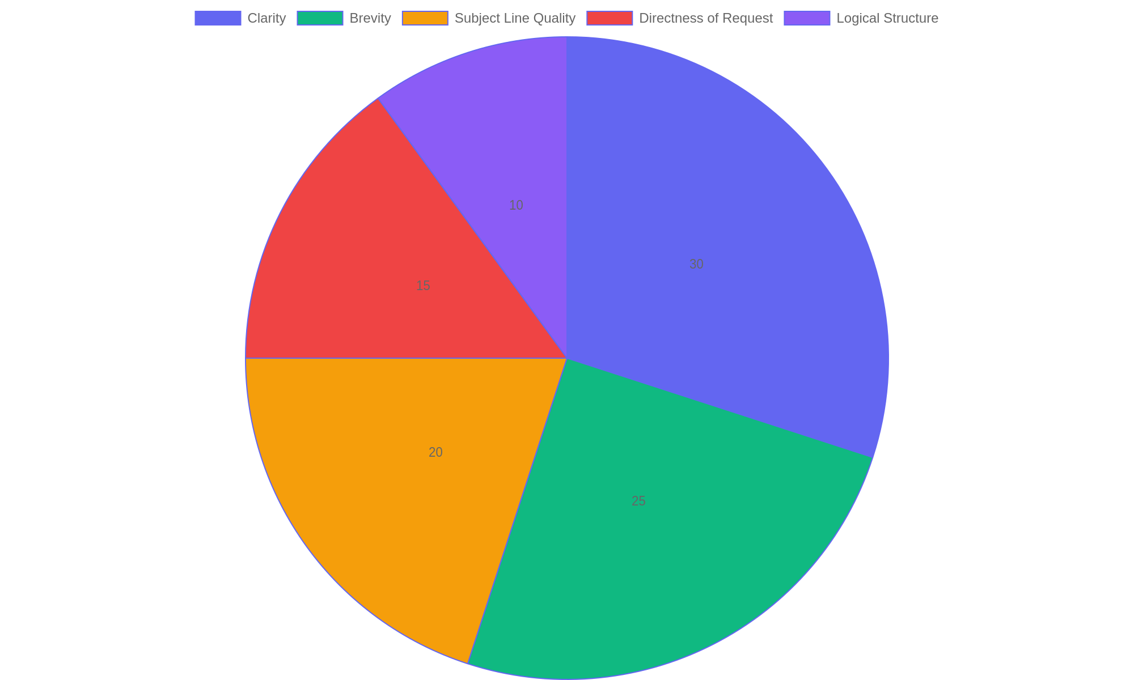
Key Elements of Effective Email Writing
Distribution of focus areas that contribute to writing impactful emails.

Slide 8
Maximizing Email Features and Integrations - Part 1
Unlocking Advanced Email Tools
Explore how modern email platforms offer powerful features that extend beyond basic messaging. By mastering scheduling, reminders, and productivity integrations, users can streamline communication and boost efficiency.
• Schedule emails to send at optimal times for recipients.
• Set customizable reminders to follow up on important messages.
• Integrate email with calendars, task managers, and note apps.
• Use templates and quick replies to save time on common responses.
• Leverage automation tools to reduce repetitive email tasks.
By using scheduling, reminders, and app integrations, users transform email from a passive inbox into an active productivity hub. These capabilities enable better time management and ensure critical communications are timely and organized.
Advanced email features empower users to manage their inbox proactively. Scheduling messages, setting reminders, and connecting with productivity applications help maintain organization and improve response times. These tools reduce manual effort and enhance workflow continuity, making email management more strategic and less time-consuming.

Slide 9
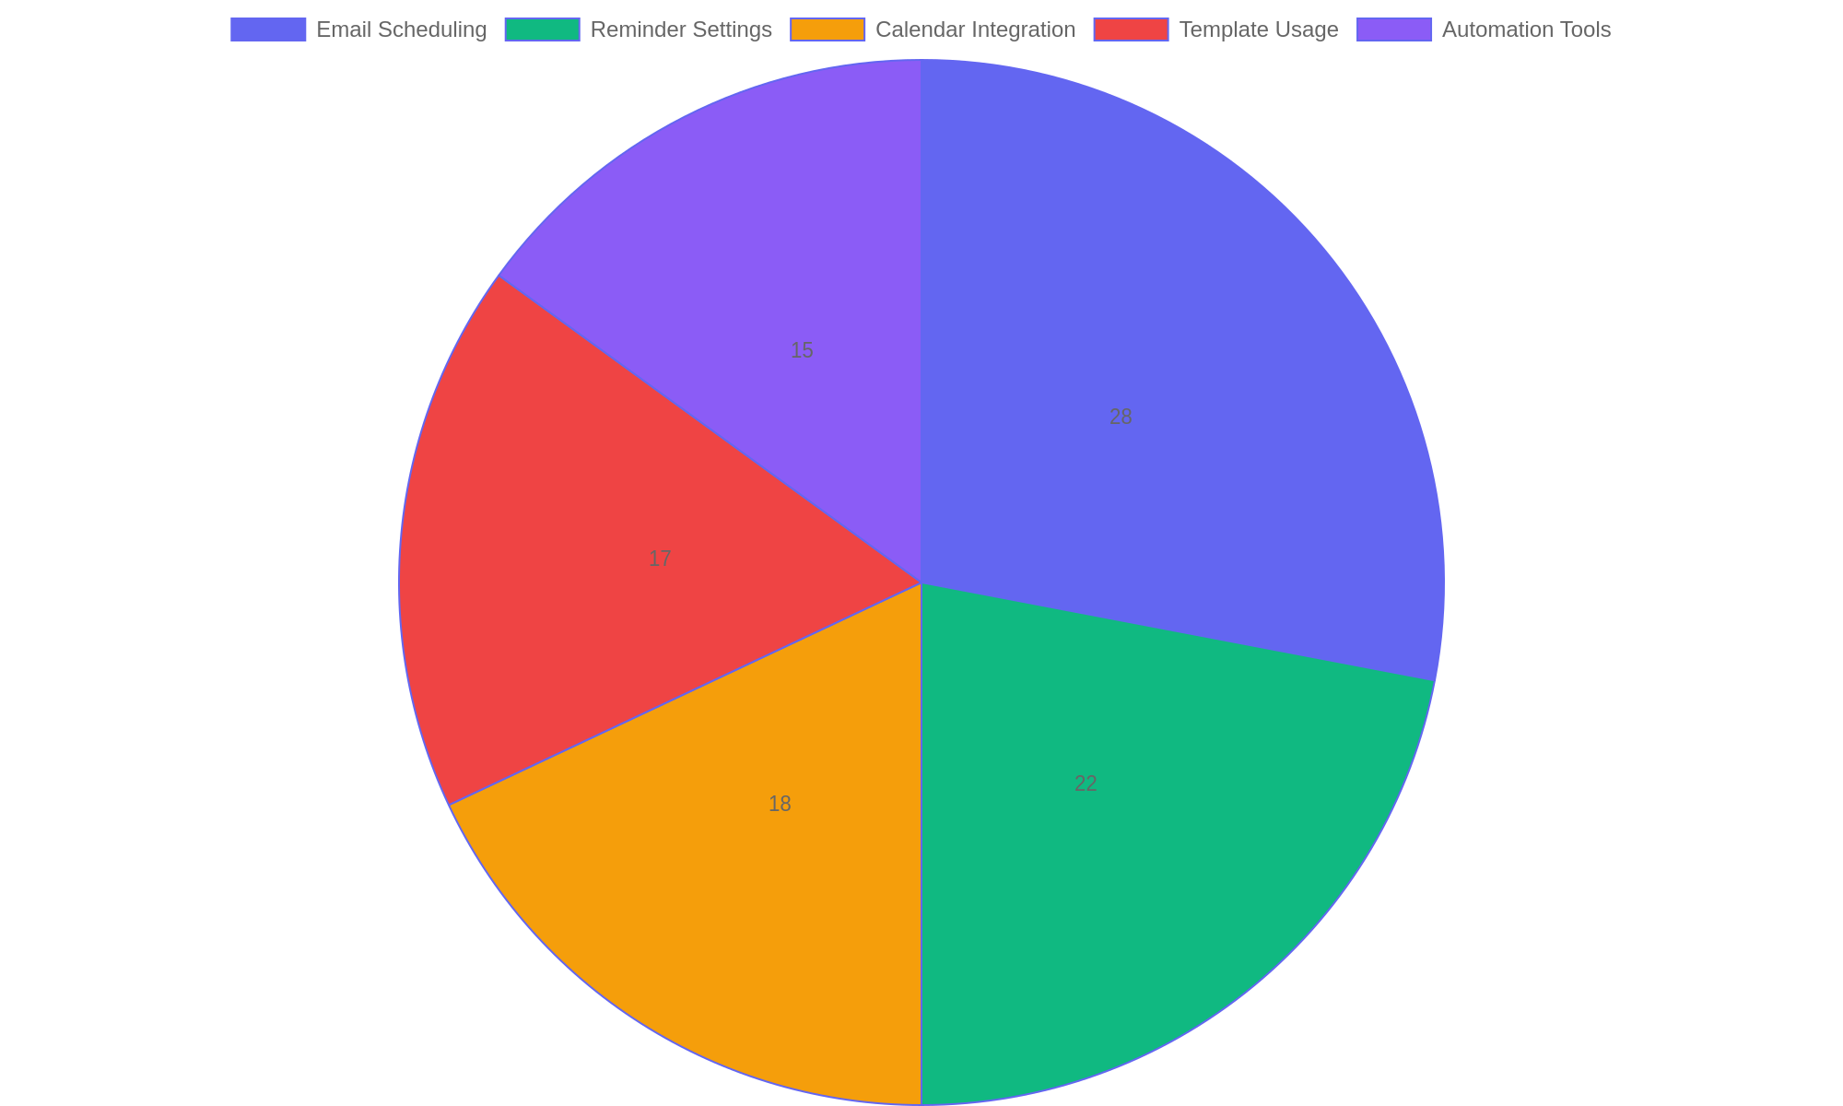
Usage Distribution of Advanced Email Features
Percentage breakdown of how users utilize advanced features in email platforms to enhance productivity.

Slide 10
Establishing a Lasting Email Management Habit - Part 1
Crafting Your Personalized Email Strategy
Developing a sustainable approach to email management ensures ongoing clarity and efficiency. By designing a routine tailored to your workflow, you can maintain an organized inbox and prevent overwhelm.
• Identify peak productivity times for email review.
• Set specific intervals for inbox maintenance.
• Create folders or labels to categorize messages effectively.
• Use filters and rules to automate sorting.
• Commit to daily or weekly review sessions to stay current.
A personalized email strategy focuses on timing, organization, and automation. Establishing fixed review periods and categorizing emails systematically fosters ongoing control. This approach minimizes clutter and promotes steady progress in managing communications effectively.
Building a lasting email management habit requires intentional planning and consistency. By understanding your unique work patterns and setting clear routines, you can keep your inbox orderly and reduce stress. Automation tools combined with regular reviews help sustain balance, ensuring your email system supports rather than hinders productivity over time.

Slide 11
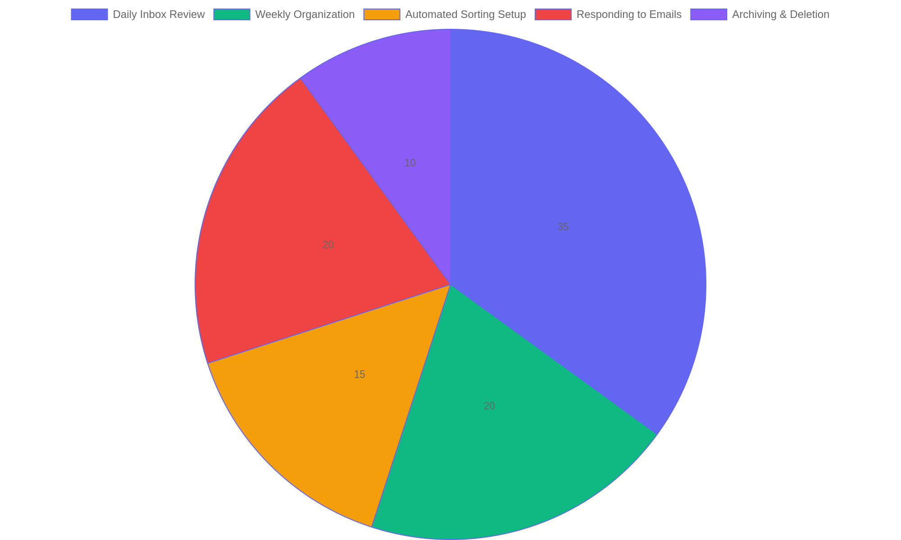
Time Allocation for Effective Email Management
Distribution of time spent on key email management activities to maintain productivity and clarity.

