Slide 1
Foundations of SOX Compliance - Part 1
Understanding SOX Origins and Purpose
The Sarbanes-Oxley Act (SOX) was enacted to restore trust in the financial reporting of publicly traded companies. This legislation emerged in response to major financial scandals, aiming to enhance transparency and accountability in corporate governance.
• Enacted in 2002 to address corporate fraud and financial misstatements.
• Introduces stricter regulations on financial disclosures and internal controls.
• Mandates executive accountability for accuracy in financial reports.
• Establishes oversight bodies to monitor compliance and protect investors.
• Focuses on improving the reliability and integrity of corporate financial data.
SOX was created to combat deceptive financial practices by enforcing rigorous standards for reporting and internal audits. It emphasizes leadership responsibility and establishes penalties for non-compliance, thereby reinforcing corporate financial integrity.
SOX compliance is rooted in the need to prevent corporate misconduct and protect investors by ensuring accurate financial reporting. The act sets clear responsibilities for company leadership and requires robust internal controls. By enforcing transparency and accountability, SOX fosters trust in the financial markets and promotes ethical corporate behavior.

Slide 2
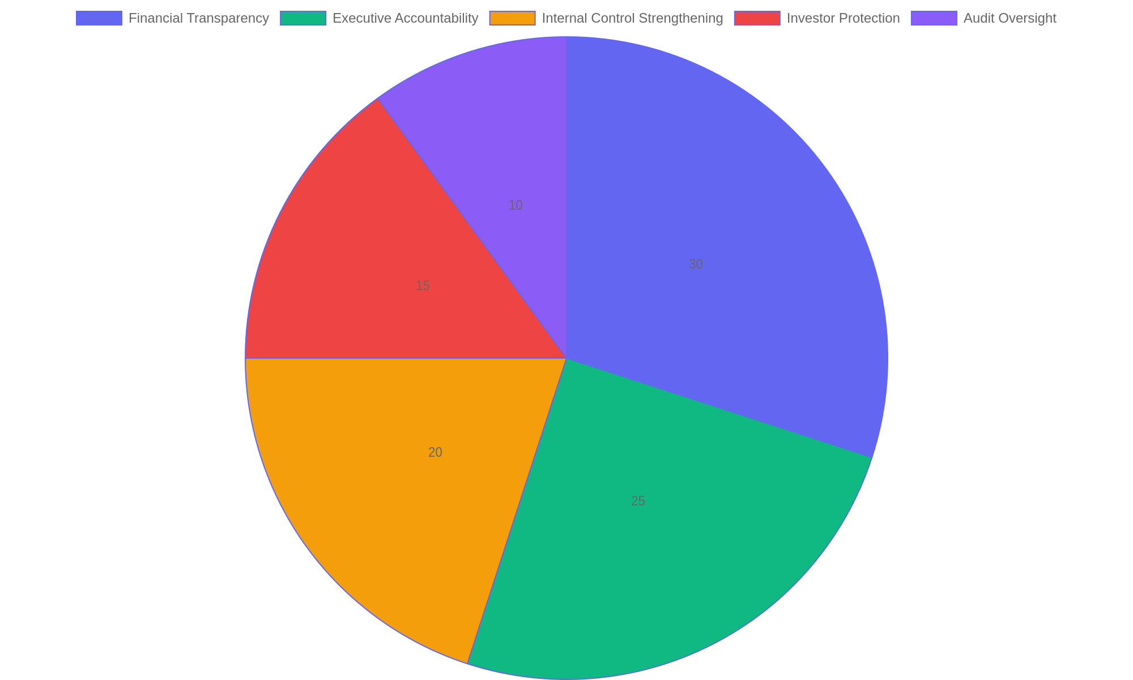
Key Objectives of SOX Compliance
Distribution of primary goals underpinning SOX compliance efforts.

Slide 3
Strategies for SOX Compliance Implementation
Key Steps to Effective Compliance
Implementing SOX compliance requires a structured approach that integrates risk assessment, thorough documentation, diligent auditing, and technological tools to maintain ongoing adherence to regulatory standards.
• Conduct comprehensive risk assessments to identify potential control weaknesses.
• Develop and maintain clear, detailed documentation of financial processes and controls.
• Establish regular internal and external audit schedules to monitor compliance.
• Utilize technology solutions for automation and real-time monitoring of controls.
• Foster a culture of accountability and continuous improvement across all departments.
A robust SOX compliance strategy blends risk analysis, precise documentation, scheduled audits, and smart technology. Emphasizing these elements creates a resilient control environment that supports continuous compliance and reduces the likelihood of financial misstatements or regulatory penalties.
Successful SOX compliance implementation hinges on a proactive framework that evaluates risks, documents controls meticulously, and supports ongoing audits. Leveraging technology enhances accuracy and efficiency, while cultivating an organizational culture committed to transparency ensures sustained adherence to SOX mandates. This integrated strategy helps organizations mitigate risks and maintain regulatory confidence.

Slide 4
Sustaining SOX Compliance Over Time
Maintaining Long-Term Compliance
Effective SOX compliance requires continuous attention beyond initial implementation. Organizations must embed ongoing evaluation, transparent reporting, and a supportive culture to ensure controls remain effective and risks are managed proactively.
• Implement regular internal audits and control assessments to identify gaps early.
• Establish clear, timely reporting channels for compliance status and issues.
• Promote a culture of accountability and ethical behavior throughout the organization.
• Adapt compliance processes to evolving regulations and business changes.
• Leverage technology for continuous monitoring and automated controls.
Long-term SOX compliance depends on regular control reviews, effective communication of compliance results, and fostering a culture that prioritizes ethical standards. Using technology and adapting to changes supports sustained adherence to requirements.
Sustaining SOX compliance is an ongoing process that involves consistent evaluation, transparent reporting, and cultivating an organizational culture that values integrity. Continuous improvement and adaptation to regulatory updates help maintain effective controls and reduce risk exposure over time. This approach ensures that compliance is not a one-time effort but a fundamental part of everyday business operations.

