Slide 1
Overview of Qualified Business Income - Part 1
Understanding Qualified Business Income
Qualified Business Income (QBI) represents the net amount of income earned from eligible businesses, which may qualify for a specific tax deduction designed to reduce taxable income for certain business owners.
• QBI includes income from sole proprietorships, partnerships, S corporations, and some trusts.
• It excludes wages earned as an employee and certain investment income.
• The deduction aims to lower the tax burden for small and medium business owners.
• Not all business types or income sources qualify for the deduction.
• Eligibility depends on income thresholds, business type, and other specific criteria.
QBI is the net income derived from qualified trades or businesses, excluding wages and investment gains. It applies mainly to pass-through entities, providing a deduction to reduce taxable income subject to specific limits and qualifications.
Qualified Business Income is a tax concept that allows eligible business owners to deduct a portion of their business income from taxable earnings. It primarily benefits owners of pass-through entities by reducing their overall tax liability. Understanding which income qualifies and the rules surrounding eligibility is essential for maximizing this deduction effectively.

Slide 2
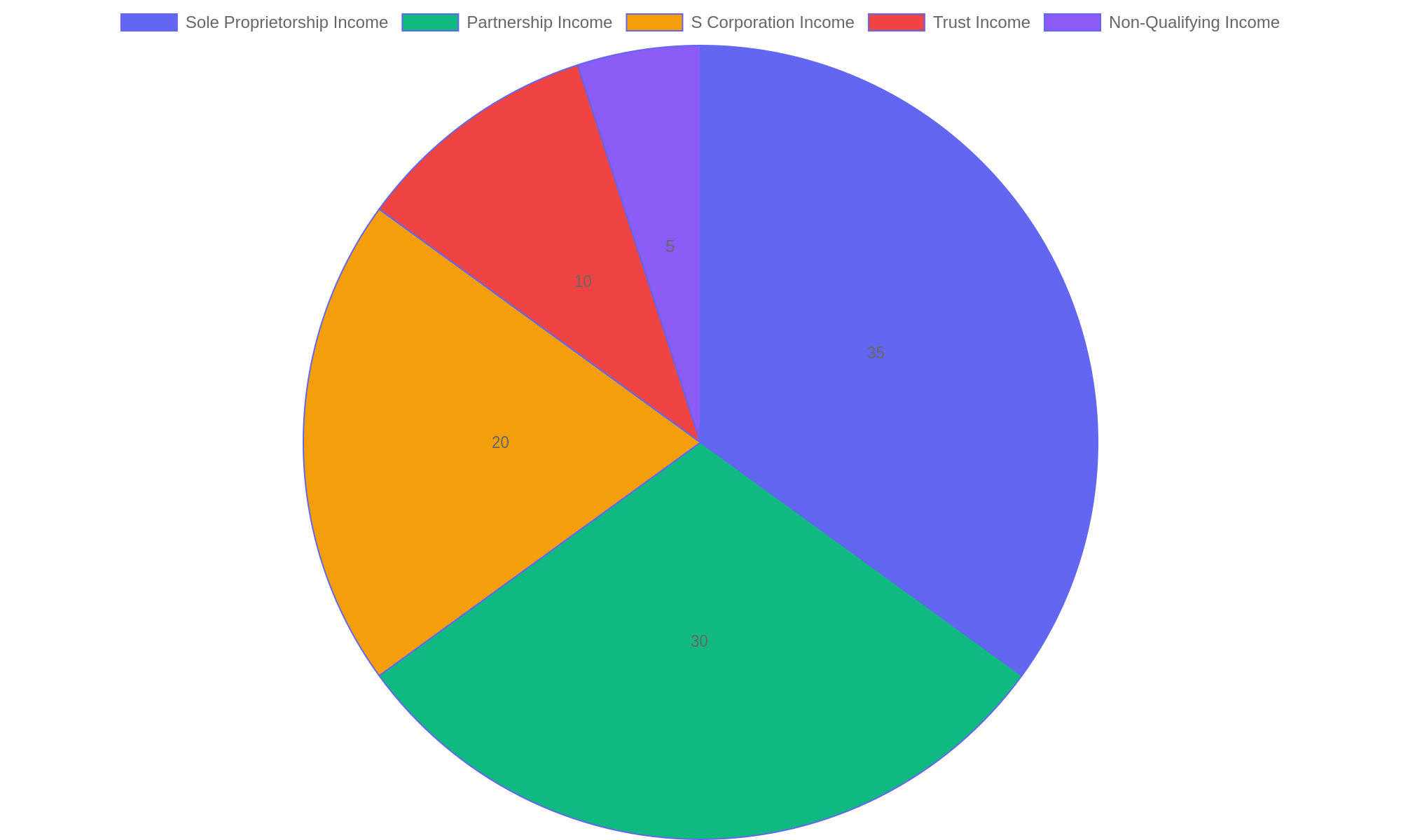
Distribution of Income Types Eligible for QBI Deduction
This pie chart illustrates the proportion of various income sources that qualify for the QBI deduction, highlighting the predominance of pass-through business income.

Slide 3
How the QBI Deduction Works
Operational Framework of QBI Deduction
Understanding how the Qualified Business Income (QBI) deduction functions requires grasping its calculation process and the types of income that qualify under tax law. This deduction allows eligible taxpayers to reduce taxable income derived from qualified businesses, subject to specific limitations and thresholds.
• QBI deduction equals up to 20% of qualified business income from eligible trades or businesses.
• Qualified income excludes wages earned as an employee and certain investment income.
• Calculation considers taxable income, with phase-outs applying for higher income levels.
• Specified service trades face additional limitations based on income thresholds.
• Deduction is computed after determining net business income and allowable adjustments.
The QBI deduction applies to qualified income from eligible businesses, capped at 20%. It excludes wage income and investment gains. Limitations depend on overall taxable income and business type, with phase-outs for certain service activities. Calculations involve net income and adjustments to determine the allowable deduction.
The QBI deduction reduces taxable income by allowing a deduction of up to 20% of qualified business income from eligible entities. It excludes wages and investment income, focusing on net business earnings. Income thresholds and business types influence the deduction limits, especially for service-based businesses. This framework ensures taxpayers benefit proportionally based on their business earnings within current tax guidelines.

Slide 4
Eligibility for QBI Deduction
Who Qualifies for the QBI Deduction?
The Qualified Business Income (QBI) deduction is designed to benefit certain taxpayers with income from qualified businesses. Eligibility depends on the type of business entity and specific income thresholds, ensuring the deduction targets active business income rather than passive or investment earnings.
• Available to individuals, trusts, and estates with qualified business income.
• Includes income from sole proprietorships, partnerships, S corporations, and some LLCs.
• Excludes wage income, capital gains, and certain investment income.
• Subject to income limits that may phase out or restrict the deduction.
• Specified service trades or businesses face additional eligibility restrictions above income thresholds.
Eligibility hinges on the business type and income level. Qualified businesses must generate active business income, excluding wages and investments. Income limits and service business restrictions further define who can claim the deduction.
The QBI deduction applies to taxpayers earning income through eligible business structures such as sole proprietorships and S corporations. It excludes non-business income and is limited by income thresholds and the nature of the trade or business. Understanding eligibility helps taxpayers optimize their tax benefits while complying with IRS rules.

Slide 5
Limitations and Exclusions in QBI Deduction
Key Restrictions on QBI Deduction
The Qualified Business Income (QBI) deduction is subject to specific limitations and exclusions that impact eligibility. These rules primarily address income from certain service trades or businesses and other factors that can reduce or eliminate the deduction. Understanding these constraints is essential for accurate tax planning and compliance.
• Specified Service Trades or Businesses (SSTBs) face phase-out limits based on income thresholds.
• High-income taxpayers may see reduced or no deduction for income from SSTBs.
• Capital-intensive businesses can benefit from wage and property-based limitations.
• Certain investment income and wages are excluded from QBI calculation.
• Aggregation rules and ownership structures can affect deduction eligibility.
QBI deduction limitations primarily target service-based businesses with income above specified limits. Exclusions include investment income and wages, while aggregation rules influence how businesses qualify. These rules prevent excessive deductions for certain professions and high earners.
The QBI deduction excludes or limits benefits for certain service industries, especially when taxable income exceeds set thresholds. These limitations ensure that high earners in specific professional fields receive reduced deductions. Additionally, income types such as investment earnings and wages are excluded. Properly applying these restrictions ensures compliance and maximizes allowable deductions within the IRS framework.

Slide 6
Step-by-Step QBI Calculation
Calculation Process Overview
This slide breaks down the method for computing the Qualified Business Income (QBI) deduction, guiding through income identification, deduction limits, and illustrative examples to clarify each step.
• Determine total qualified business income from all eligible trades or businesses.
• Subtract any losses from qualified businesses to find net QBI.
• Identify taxable income to check if income thresholds affect the deduction.
• Apply applicable percentage limits and wage/property caps based on business type.
• Calculate the final QBI deduction, ensuring it does not exceed 20% of taxable income.
Start by totaling qualified business income and subtracting losses. Assess taxable income against IRS thresholds to identify any reduction in deduction. Incorporate wage and capital limits when applicable. Finally, compute the deduction as the lesser of 20% of QBI or 20% of taxable income after adjustments.
Calculating the QBI deduction involves a structured approach: first, isolating net qualified business income by aggregating gains and losses; next, comparing taxable income against threshold limits to determine if phase-in rules apply. Then, wage and capital limits are applied where relevant, culminating in a deduction that cannot exceed 20% of taxable income. Real-world examples help clarify each stage, ensuring precise application.

Slide 7
QBI Deduction Reporting on Tax Returns
Reporting Essentials
Understanding how to properly report the Qualified Business Income (QBI) deduction on tax returns is crucial for maximizing tax benefits while ensuring compliance. This involves specific IRS forms, correct calculation methods, and awareness of how QBI interacts with other deductions and credits.
• Report QBI deduction on IRS Form 1040, using Form 8995 or 8995-A for calculation.
• Ensure proper aggregation of qualified trades or businesses when applicable.
• Be mindful of income thresholds that affect deduction limits and phase-outs.
• Coordinate QBI deduction with other deductions such as self-employment tax and retirement contributions.
• Maintain detailed records to support QBI amounts and related adjustments during audits.
Taxpayers calculate the QBI deduction primarily on Form 8995 or 8995-A, then transfer the result to Form 1040. Income thresholds influence deduction limits, and aggregation rules can affect eligibility. Coordination with other tax benefits is essential to avoid overlap or errors.
The QBI deduction must be reported accurately using designated IRS forms to reflect eligible income and comply with tax laws. Taxpayers need to consider income thresholds and aggregation rules to determine the correct deduction amount. Additionally, the QBI deduction interacts with various other tax credits and deductions, requiring careful coordination to optimize overall tax outcomes while maintaining thorough documentation.

Slide 8
Avoiding Common QBI Pitfalls
Key Challenges in QBI Deduction
Understanding frequent errors can help taxpayers maximize their Qualified Business Income deduction while minimizing audit risks. This slide highlights typical misunderstandings and practical advice to avoid costly mistakes during tax filing.
• Misclassifying income sources leading to incorrect QBI calculations.
• Neglecting wage and property limitations that affect deduction eligibility.
• Overlooking phase-out thresholds for higher-income taxpayers.
• Confusing specified service trade or business (SSTB) rules and their impact.
• Failing to properly aggregate multiple businesses when applicable.
Avoid errors by verifying income classification, applying wage and asset limits correctly, and understanding SSTB constraints. Proper aggregation of related businesses can also optimize the deduction and reduce audit exposure.
Taxpayers often stumble over complex QBI rules, resulting in missed deductions or compliance issues. Common pitfalls include misidentifying qualified income, ignoring wage/property caps, and misunderstanding SSTB restrictions. Awareness of these challenges, combined with careful record-keeping and professional guidance, ensures accurate deduction claims and smoother tax season navigation.

Slide 9
Conclusion and Practical QBI Tips
Summary and Strategic Guidance
This segment consolidates the essential elements of the Qualified Business Income deduction, emphasizing how to apply these insights to maximize tax benefits while maintaining compliance.
• Understand the core eligibility criteria to accurately determine QBI deduction limits.
• Monitor taxable income thresholds to plan income recognition and optimize deduction phases.
• Leverage aggregation rules for related businesses to enhance deduction potential.
• Stay updated on changes in tax laws affecting QBI to adapt strategies promptly.
• Maintain thorough documentation to support QBI calculations and withstand audits.
Effective QBI management hinges on understanding deduction rules, tracking income levels, and applying aggregation options. Staying informed and organized enables taxpayers to claim the maximum allowable deduction and reduce audit risks.
Mastering the Qualified Business Income deduction requires a clear grasp of eligibility, income thresholds, and aggregation guidelines. By strategically managing these factors and keeping abreast of regulatory updates, taxpayers can effectively increase their tax savings. Proper record-keeping and proactive planning are key to maximizing benefits while ensuring compliance with tax requirements.

