Slide 1
Overview of Nursing Services - Part 1
Essential Roles of Nursing
Nursing services are a vital component of healthcare, focusing on promoting patient health, preventing illness, and supporting recovery. Nurses act as caregivers, advocates, educators, and collaborators within medical teams to ensure holistic patient care and efficient facility operation.
• Provide direct patient care including monitoring and treatment administration
• Educate patients and families on health management and disease prevention
• Coordinate with healthcare professionals to develop and implement care plans
• Support emotional and psychological needs of patients during treatment
• Maintain accurate documentation and ensure compliance with health standards
Nurses play multifaceted roles that extend beyond clinical duties to include patient education, emotional support, and collaboration with healthcare teams. Their contributions are essential to patient outcomes and the smooth operation of healthcare facilities.
Nursing services form the backbone of patient-centered healthcare by delivering comprehensive care that addresses physical, emotional, and educational needs. Nurses bridge the gap between patients and the broader medical team, ensuring treatments are personalized and effective. Their roles encompass clinical tasks, communication, and advocacy, all crucial for maintaining quality and safety within healthcare environments.

Slide 2
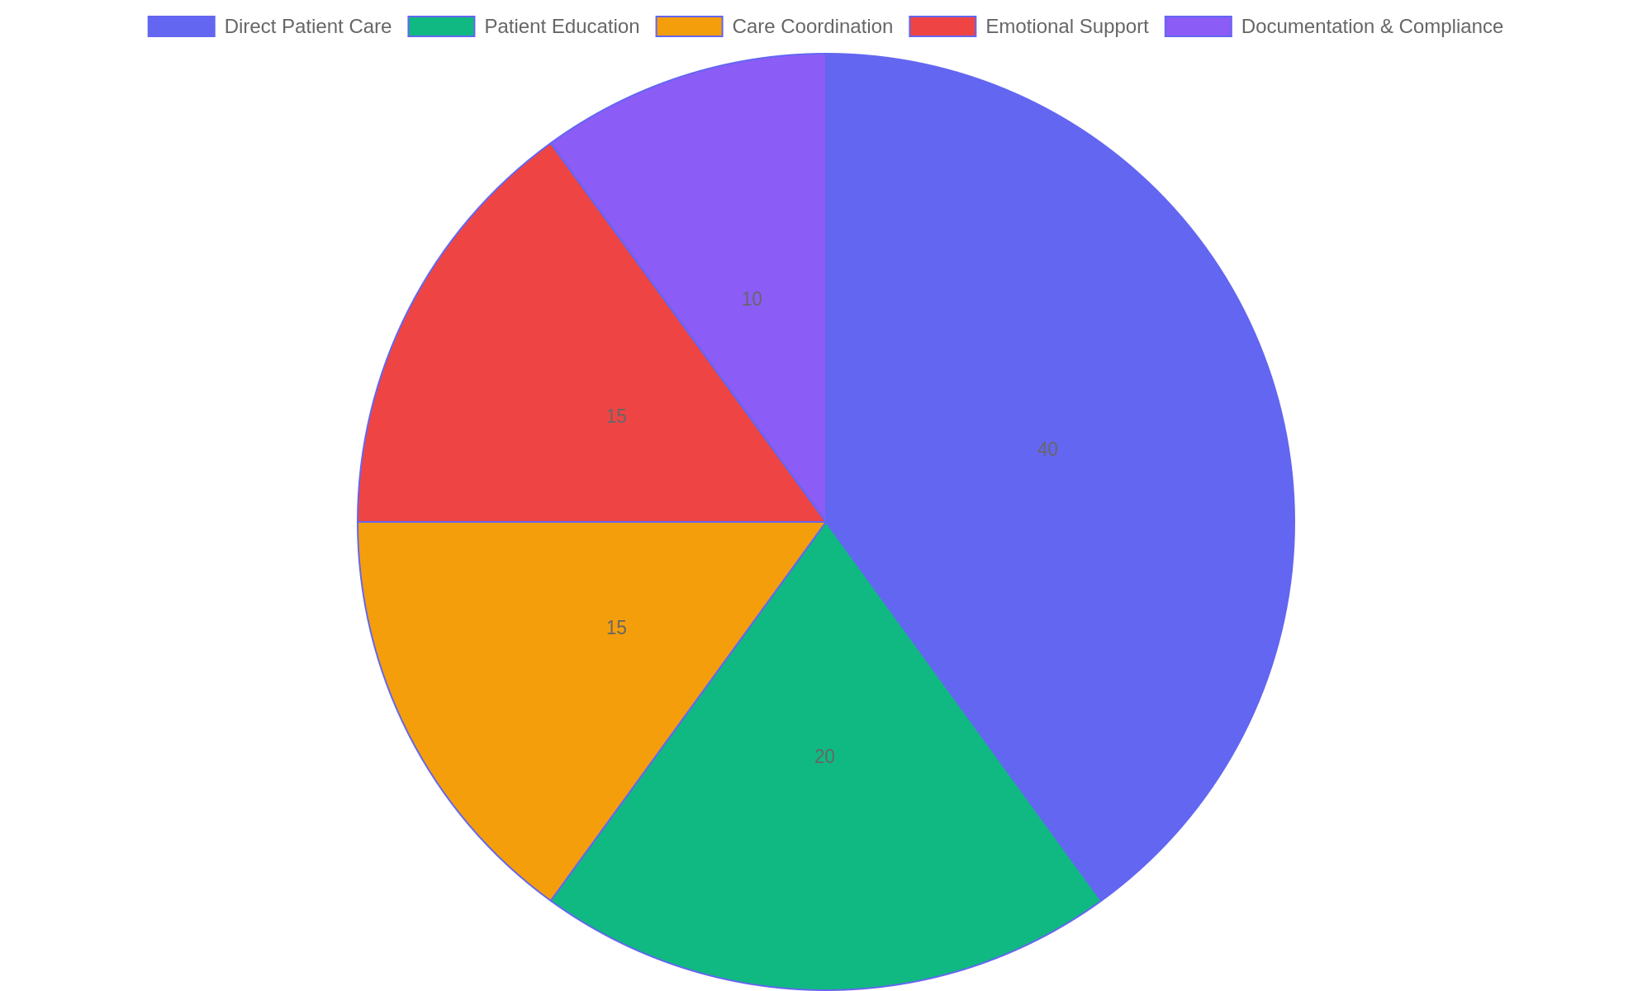
Distribution of Key Nursing Responsibilities
This pie chart illustrates the proportional focus of nursing responsibilities, emphasizing the significant role of direct patient care alongside education, coordination, emotional support, and administrative duties.

Slide 3
Core Patient Care Techniques - Part 1
Fundamental Approaches to Patient Care
Mastering core patient care techniques ensures that nurses provide safe, effective, and empathetic support. This involves thorough patient assessments, routine care procedures, and communication strategies that build trust and comfort.
• Conduct comprehensive patient assessments to identify health needs promptly.
• Perform basic care tasks such as hygiene assistance and vital sign monitoring.
• Apply infection control practices to maintain a safe care environment.
• Use clear and compassionate communication to enhance patient cooperation.
• Document care activities accurately to support continuity and accountability.
Effective patient care hinges on combining clinical skills with empathetic interaction. Nurses assess conditions, carry out essential procedures, and communicate clearly to support patient needs and build trust throughout the care process.
Core patient care techniques form the foundation for nursing excellence. They include accurate assessments, essential care routines, and communication skills that foster positive patient relationships. By integrating these elements, nurses can deliver personalized care that promotes recovery and wellbeing while ensuring safety and respect.

Slide 4
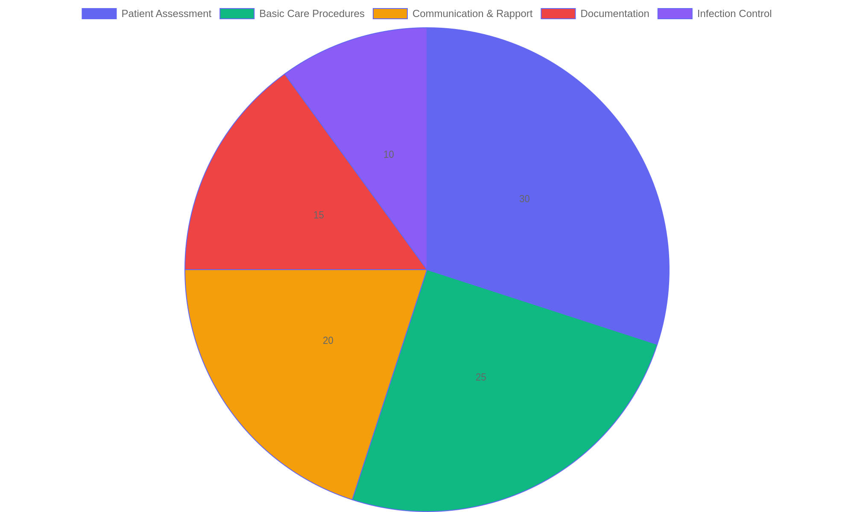
Time Allocation in Core Patient Care Activities
Distribution of time spent by nurses on key patient care activities, highlighting the balance between technical tasks and interpersonal communication.

Slide 5
Standard Nursing Procedures
Core Nursing Practices
Standard nursing procedures establish a consistent framework for delivering safe and effective patient care. These procedures cover critical tasks such as medication administration, wound care, and infection prevention, ensuring that nurses follow best practices to promote healing and reduce risks.
• Administer medications accurately following prescribed dosages and timings.
• Perform wound assessment and management to support recovery and prevent complications.
• Implement infection control protocols including hand hygiene and use of personal protective equipment.
• Monitor patient vital signs regularly to detect early signs of deterioration.
• Document all nursing interventions clearly to maintain continuity of care.
Nurses apply standardized methods to administer treatments, manage wounds, and prevent infections. Consistent documentation and monitoring are integral to these procedures, enabling timely interventions and promoting optimal patient outcomes.
Standard nursing procedures are essential for maintaining high-quality patient care and safety. By adhering to these protocols, nurses ensure effective medication delivery, proper wound management, and robust infection control. These practices not only support patient recovery but also minimize risks of errors and healthcare-associated infections, fostering a safe environment for both patients and healthcare providers.

Slide 6
Enhanced Clinical Competencies
Advancing Nursing Expertise
This segment focuses on elevating nursing proficiency through refined clinical skills. Emphasis is placed on critical thinking, sound clinical judgments, and integrating cutting-edge technologies alongside evidence-based practices to improve patient outcomes in daily nursing care.
• Develop analytical skills for complex patient assessments
• Enhance clinical decision-making under varied scenarios
• Incorporate innovative medical technologies into practice
• Apply evidence-based methodologies consistently
• Foster continuous learning to adapt to healthcare advancements
Advanced clinical competencies empower nurses to evaluate situations critically and apply the latest technologies and research findings. This ensures precise decision-making and improved quality of care tailored to individual patient needs.
Enhancing clinical competencies involves deepening nurses' ability to analyze patient conditions critically, make informed decisions, and integrate new technologies effectively. This approach ensures that nursing care remains current, efficient, and patient-centered by utilizing evidence-based strategies and fostering adaptability in a dynamic healthcare environment.

Slide 7
Integrity and Professional Standards in Nursing
Core Ethical Principles and Responsibilities
Nursing practice is grounded in ethical principles that guide professionals to deliver respectful, honest, and compassionate care. Maintaining patient confidentiality, securing informed consent, and advocating for patient rights are essential duties that uphold trust and integrity within healthcare settings.
• Protect patient privacy by safeguarding confidential information.
• Ensure patients understand and voluntarily agree to treatments through informed consent.
• Act as a dedicated advocate to support patients’ best interests and rights.
• Adhere to professional codes of conduct and ethical guidelines consistently.
• Demonstrate honesty and accountability in all nursing interactions and decisions.
Integrity in nursing involves consistently applying ethical standards such as confidentiality, informed consent, and advocacy. These responsibilities ensure that nurses provide care that respects patient autonomy and promotes trust, reinforcing the professional values essential to quality healthcare delivery.
Nurses must embody integrity by strictly following ethical standards that protect patient dignity and autonomy. This includes respecting confidentiality, facilitating informed decisions, and championing patient welfare. Upholding these principles fosters trust between patients and healthcare providers, ensuring care is both ethical and professional in every circumstance.

Slide 8
Innovations in Nursing Practices
Emerging Trends Shaping Nursing
Nursing is rapidly evolving through new approaches and technologies that enhance patient care and professional collaboration. Innovations such as telehealth, integrated care models, and advanced digital tools are redefining how nurses deliver services and interact with patients in diverse settings.
• Telehealth expands access by enabling remote patient monitoring and consultations.
• Collaborative care models promote teamwork across healthcare disciplines for holistic treatment.
• Health technology advancements improve accuracy, efficiency, and data management.
• Wearable devices and mobile apps support real-time health tracking and patient engagement.
• Artificial intelligence assists in decision-making and personalized care planning.
Innovations in nursing focus on leveraging technology and teamwork to improve outcomes. Telehealth facilitates remote interactions, collaborative models enhance multidisciplinary care, and digital tools streamline processes. Together, these changes promise a future where nursing adapts to evolving patient needs with greater flexibility and effectiveness.
The nursing profession is embracing innovations that transform traditional care delivery. Telehealth breaks geographical barriers, while collaborative frameworks foster integrated approaches to patient health. Technological progress, including AI and wearable devices, empowers nurses to provide timely, precise, and patient-centered care, ultimately shaping a more connected and efficient healthcare environment.

