Slide 1
The Role of Financial Literacy in Human Resources - Part 1
Understanding Financial Literacy in HR
Financial literacy equips HR professionals with the knowledge to interpret and utilize financial data, enabling better decision-making that aligns with organizational goals.
• Enhances understanding of budgeting and compensation strategies
• Supports informed talent acquisition decisions based on cost analysis
• Improves negotiation skills for benefits and salary packages
• Enables evaluation of workforce productivity in financial terms
• Facilitates collaboration with finance and executive teams
HR professionals with financial literacy can better assess costs related to hiring and retention, ensuring resource allocation supports overall business objectives effectively.
Financial literacy empowers HR practitioners to navigate complex financial information, improving their ability to contribute strategically. This knowledge impacts key HR functions like recruitment, retention, and workforce planning by aligning decisions with budgetary constraints and organizational profitability.

Slide 2
The Role of Financial Literacy in Human Resources - Part 2
Impact on Talent Acquisition and Retention
Financial literacy allows HR to design competitive yet sustainable compensation packages, directly influencing the attraction and retention of quality talent.
• Analyzes market salary trends to set appropriate pay scales
• Balances budget limits with employee expectations
• Forecasts financial impact of hiring decisions
• Identifies cost-effective training and development investments
• Monitors turnover costs and retention program ROI
Financially literate HR professionals assess hiring costs and retention expenses to optimize workforce investments, ensuring long-term organizational stability.
By understanding financial principles, HR teams can create compensation and benefits strategies that attract skilled employees while maintaining fiscal responsibility. This balance helps reduce turnover and enhances staff loyalty by aligning rewards with organizational capacity.

Slide 3
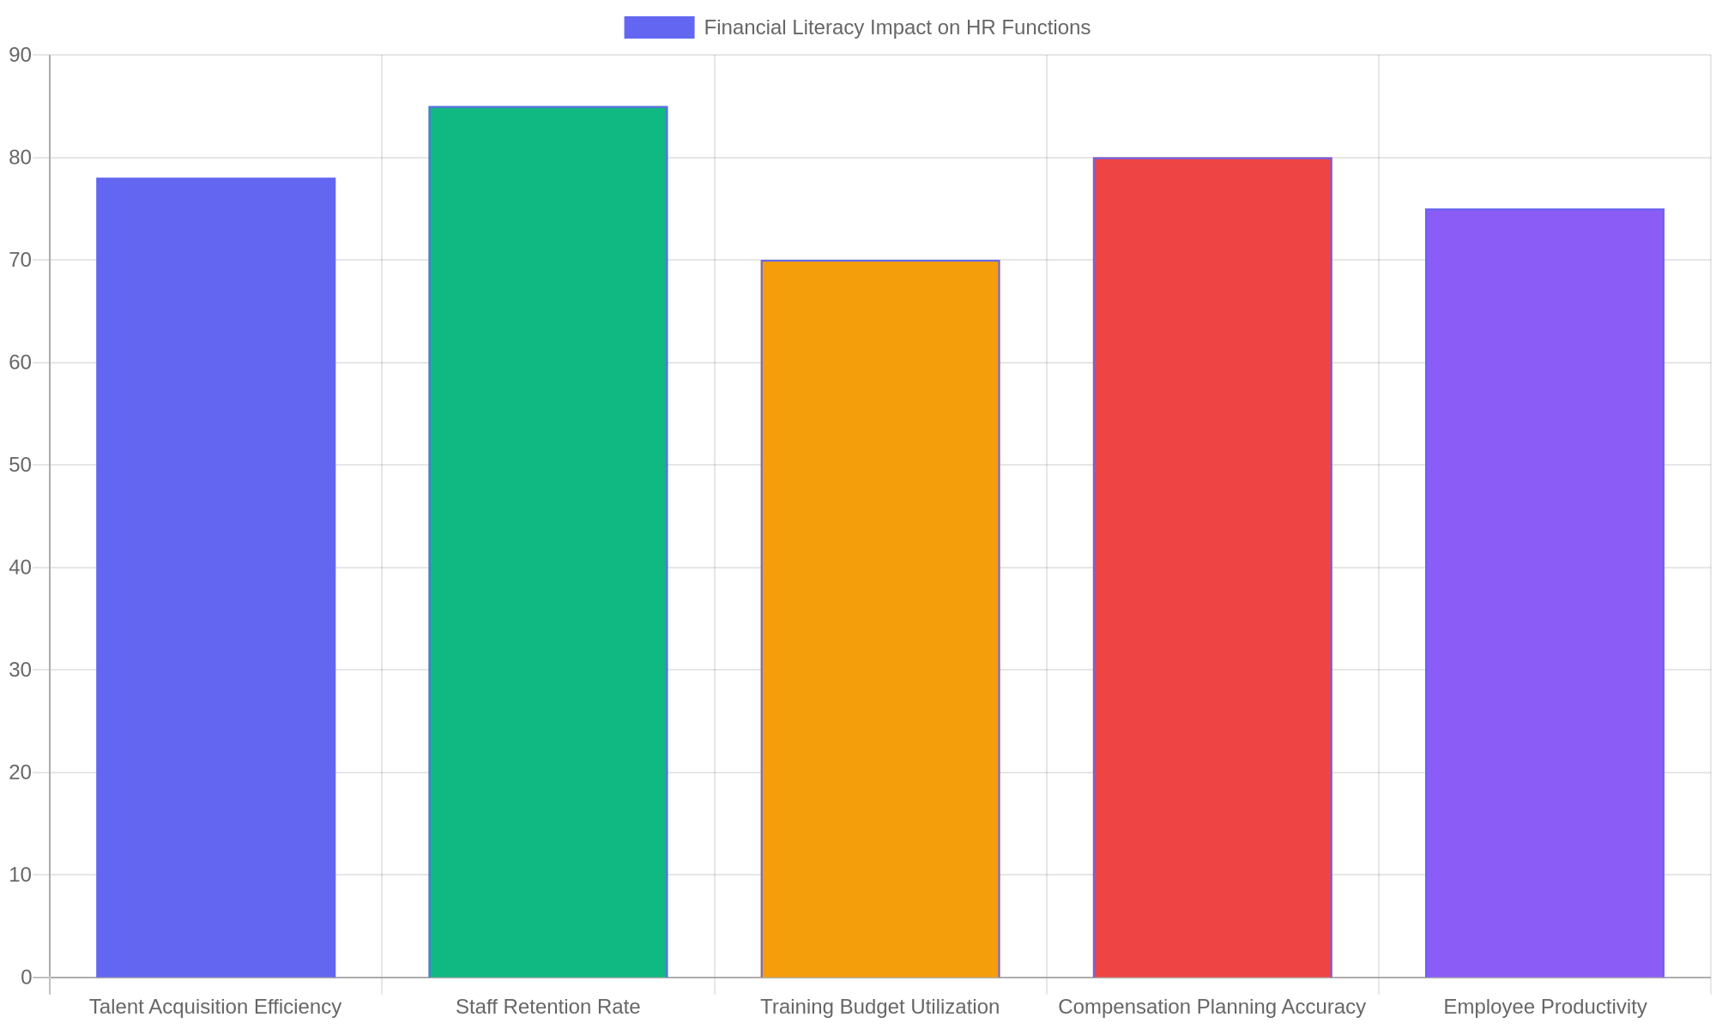
Financial Literacy Impact on HR Functions
Bar chart illustrating the positive influence of financial literacy on various HR performance metrics.

Slide 4
The Role of Financial Literacy in Human Resources - Part 4
Enhancing Organizational Effectiveness
Financially knowledgeable HR professionals contribute to overall organizational success by aligning human capital strategies with financial goals.
• Supports strategic workforce planning with cost analysis
• Improves alignment between HR initiatives and business objectives
• Facilitates risk management in employee-related expenditures
• Enables transparent communication with stakeholders
• Promotes efficient use of resources across departments
HR’s financial insight helps optimize human capital investments, ensuring that workforce strategies contribute positively to the company’s financial health.
Integrating financial literacy into HR practices strengthens the connection between people management and business performance. This integration ensures HR initiatives are financially viable and support sustainable growth and competitiveness.

Slide 5
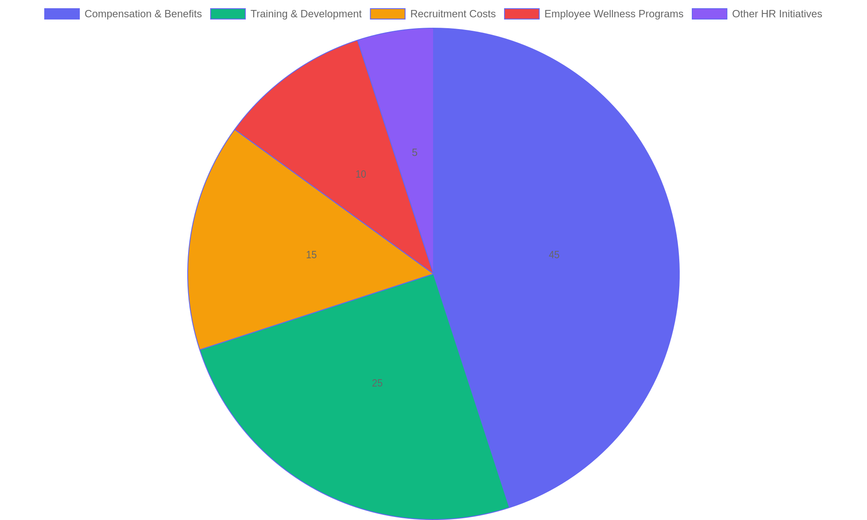
Budget Allocation Influenced by HR Financial Literacy
Pie chart showing how financial literacy guides HR budget distribution across key areas.

Slide 6
Exploring Compensation Frameworks - Part 1
Understanding Compensation Structures
Compensation frameworks define how employees are rewarded for their work. These structures balance fixed salaries with variable pay elements to align employee efforts with company goals. HR professionals must grasp these frameworks to design packages that attract, retain, and motivate talent effectively.
• Fixed salary provides stable, predictable income.
• Variable pay links rewards to individual or team performance.
• Benefits and incentives complement base pay.
• Compensation frameworks reflect organizational values and goals.
• Effective frameworks support employee engagement and retention.
Compensation frameworks blend base salary with performance incentives and benefits. This design ensures pay aligns with both employee contributions and organizational aims, fostering motivation and loyalty.
Compensation frameworks combine various pay components to create a balanced reward system. By integrating fixed and performance-based elements, organizations can motivate employees while maintaining financial stability. Understanding these structures helps HR professionals tailor compensation to support strategic objectives and enhance workforce satisfaction.

Slide 7
Exploring Compensation Frameworks - Part 2
Types of Salary Structures
Salary structures vary widely, impacting how employees perceive fairness and motivation. Common models include hourly wages, fixed monthly salaries, and banded salary ranges. Each type has distinct advantages depending on job roles, industry standards, and organizational culture.
• Hourly wages reward time worked, suited for variable schedules.
• Fixed salaries offer consistency and simplify budgeting.
• Salary bands provide flexibility within defined pay ranges.
• Market-based pay adjusts salaries according to external benchmarks.
• Skill-based pay rewards employees for acquiring new competencies.
Salary structures must reflect job demands and market trends. Options include hourly, fixed, banded, market-driven, and skill-based pay, each supporting different motivational and operational goals.
Selecting the right salary structure is crucial for aligning compensation with job requirements and market conditions. HR professionals must evaluate the nature of roles and organizational priorities to choose models that ensure fairness, motivate employees, and maintain competitiveness.

Slide 8
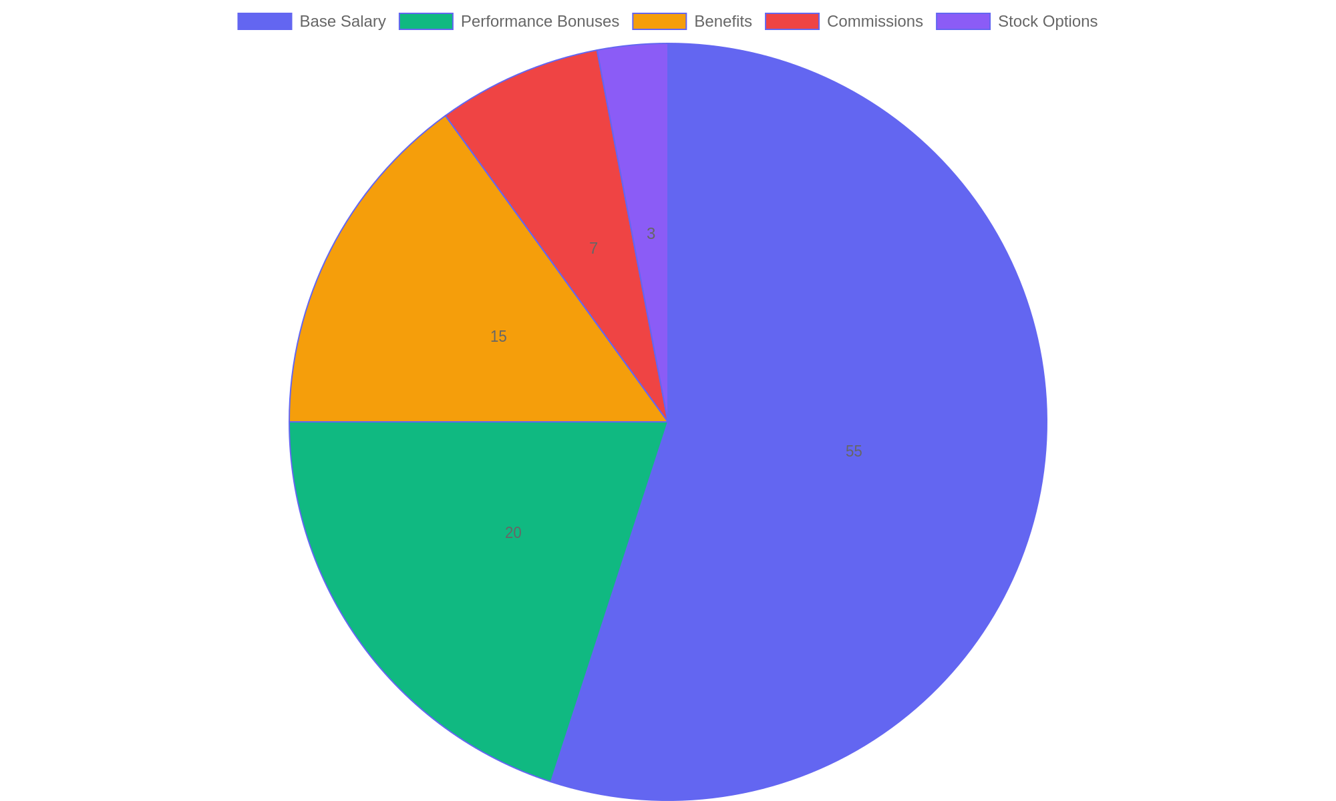
Distribution of Compensation Components
Percentage breakdown of typical compensation package elements demonstrating the relative weight of fixed and variable pay.

Slide 9
Exploring Compensation Frameworks - Part 4
Performance-Related Pay Mechanisms
Performance-related pay links financial rewards directly to measurable employee achievements. This approach encourages productivity by rewarding outcomes rather than effort alone. HR must design fair and transparent criteria to maximize motivation and minimize disputes.
• Bonuses awarded for meeting or exceeding targets.
• Commission structures common in sales roles.
• Profit-sharing aligns employee rewards with company success.
• Merit pay increases based on performance evaluations.
• Incentive plans foster goal-oriented behaviors.
Linking pay to performance encourages employees to focus on results. Various methods include bonuses, commissions, profit-sharing, and merit increases tailored to organizational goals.
Performance-related pay systems motivate employees by financially recognizing their contributions to organizational success. Properly structured, these mechanisms drive higher productivity and engagement, while supporting strategic priorities through clear, objective reward criteria.

Slide 10
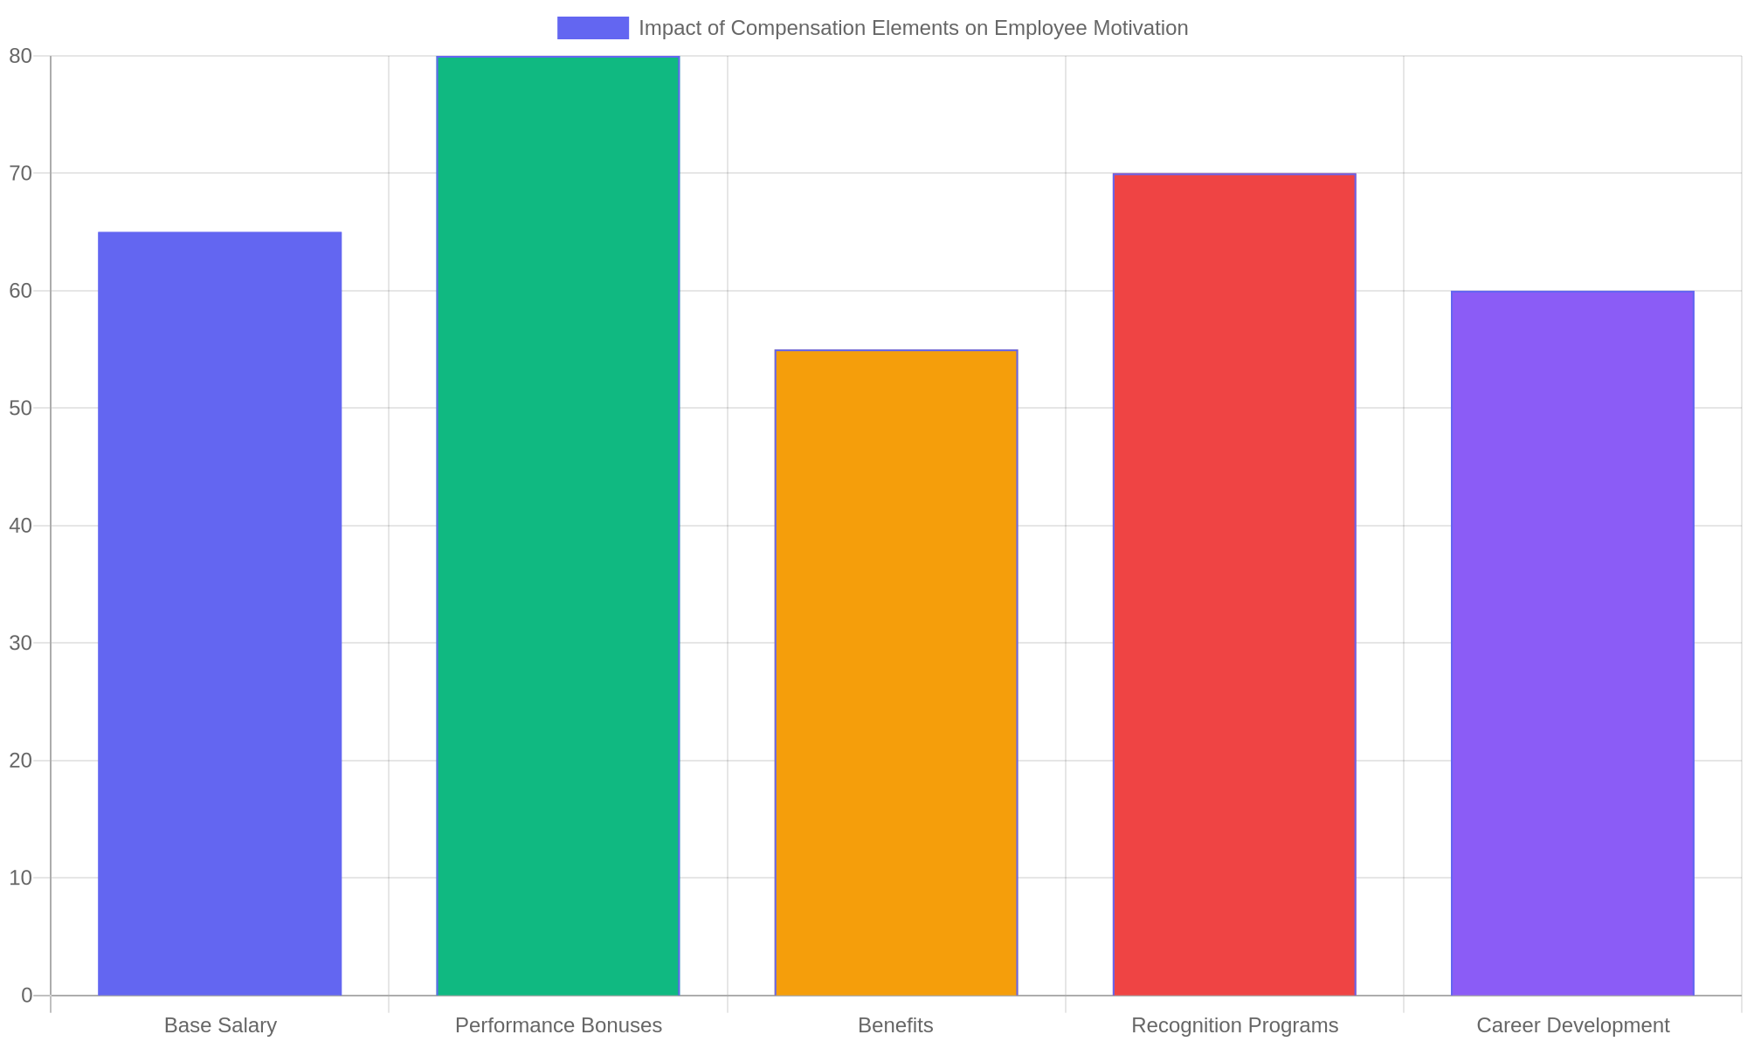
Impact of Compensation Elements on Employee Motivation
Survey results showing the influence of different compensation components on employee motivation levels.

Slide 11
Foundations of HR Budgeting - Part 1
Understanding HR Budgeting Basics
HR budgeting involves planning and managing financial resources dedicated to human resources activities. It ensures that the HR department operates efficiently within financial limits while supporting organizational goals.
• Defines financial planning for HR functions and initiatives.
• Aligns HR spending with company strategy and priorities.
• Includes costs such as recruitment, training, and employee benefits.
• Requires collaboration between HR and finance teams.
• Supports forecasting and controlling HR-related expenses.
HR budgeting sets the foundation for managing personnel costs and HR projects. It involves estimating expenses, monitoring spending, and adjusting allocations to meet evolving organizational needs without compromising financial health.
Effective HR budgeting is essential for balancing the needs of the workforce with the organization’s financial capacity. It ensures resources are allocated wisely to support recruitment, development, and retention while preventing overspending. Clear budgeting practices help HR professionals contribute to overall business success by maintaining cost-efficiency and enabling strategic decision-making.

Slide 12
Foundations of HR Budgeting - Part 2
Key Components of HR Budgeting
Breaking down HR budgets into distinct categories helps clarify where funds are directed and enhances accountability. Understanding these components is crucial for accurate forecasting and cost control.
• Salaries and wages for HR staff and employees.
• Recruitment expenses including advertising and agency fees.
• Employee training and professional development costs.
• Benefits administration such as health insurance and retirement plans.
• HR technology and software subscriptions.
HR budgets typically cover direct personnel costs, recruitment activities, development programs, benefits management, and technology investments. Each category requires detailed estimation and ongoing review to maintain budget accuracy.
A comprehensive HR budget accounts for multiple cost areas, ensuring no aspect of workforce management is overlooked. By categorizing expenses, HR professionals can prioritize initiatives, identify savings opportunities, and justify budget requests with precise data.

Slide 13
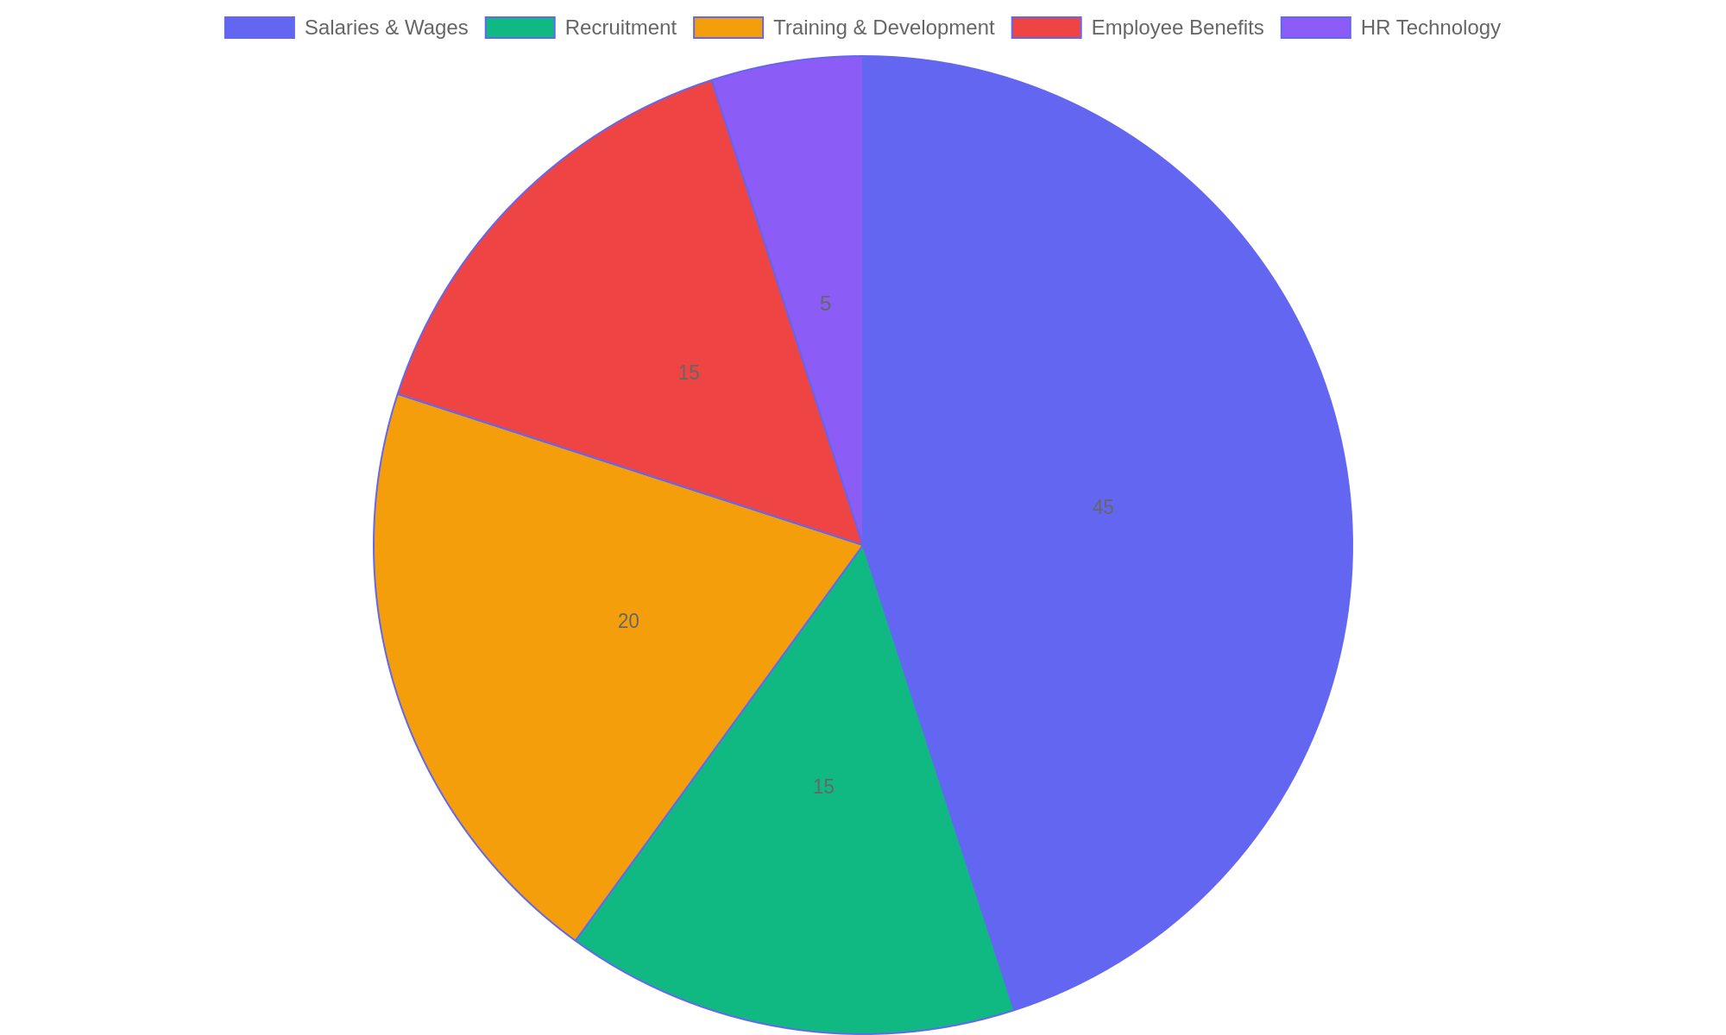
Typical HR Budget Allocation Breakdown
Distribution of budget percentages across major HR expense categories.

Slide 14
Foundations of HR Budgeting - Part 4
Forecasting and Monitoring HR Budgets
Accurate forecasting and diligent monitoring are critical to maintaining financial control over HR activities. These processes help anticipate future needs and prevent budget overruns.
• Analyze historical spending trends to predict future costs.
• Incorporate organizational changes and growth plans.
• Set realistic budget limits based on available resources.
• Regularly track expenditures against the budget.
• Adjust forecasts and allocations as conditions evolve.
Effective budgeting requires combining past financial data with strategic insights to estimate future HR costs. Ongoing review of actual spending ensures alignment with projections and helps identify areas needing adjustment.
Forecasting enables HR professionals to prepare for upcoming financial demands by considering past data and future strategies. Continuous monitoring ensures expenditures stay within planned limits, allowing timely interventions and informed decision-making to maintain budget integrity.

Slide 15
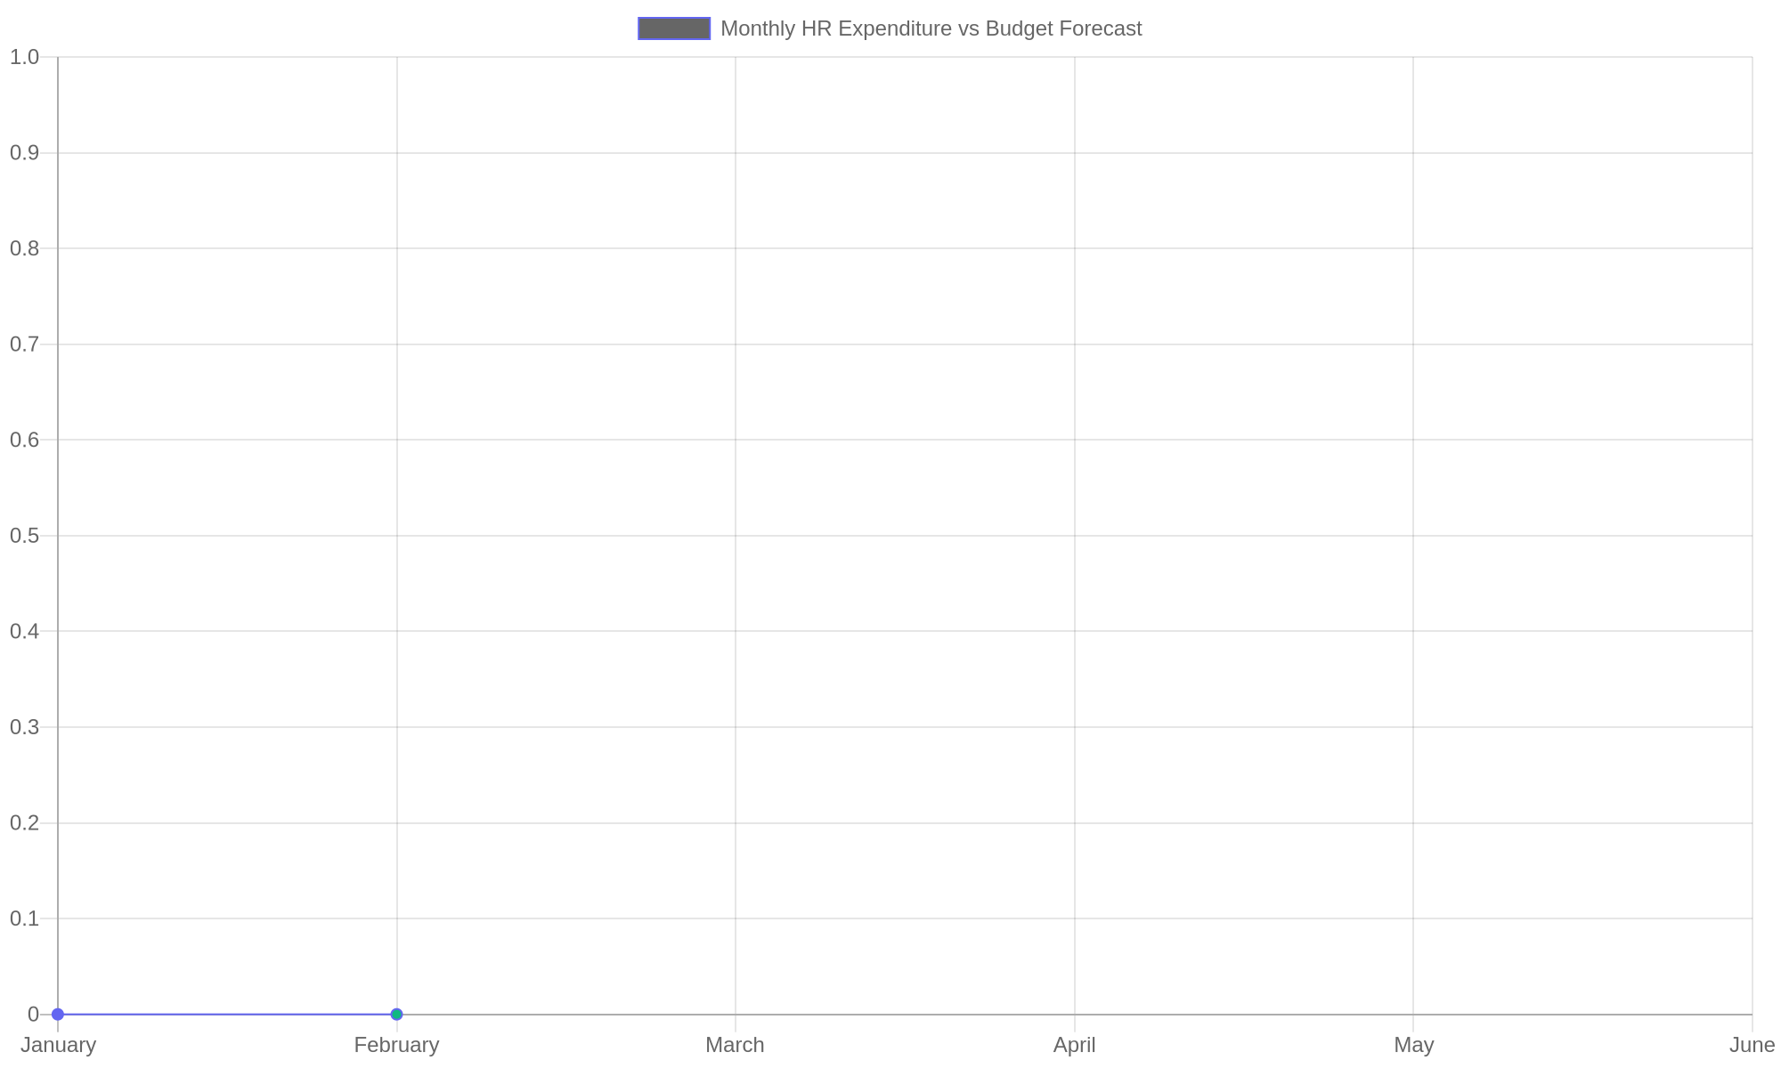
Monthly HR Expenditure vs Budget Forecast
Comparison of projected HR budget versus actual spending over six months.

Slide 16
Key Financial Indicators in HR Evaluation - Part 1
Understanding Financial Metrics in HR
Financial indicators provide measurable insights into the effectiveness and efficiency of HR initiatives. They help quantify the impact of workforce decisions and align HR strategies with overall business goals.
• Return on Investment (ROI) measures the financial benefits gained from HR projects relative to their costs.
• Hiring Costs include all expenses associated with recruiting, onboarding, and training new employees.
• Employee Attrition Expenses account for the financial impact of turnover, including lost productivity and replacement costs.
• Cost per Hire helps evaluate recruitment efficiency by dividing total hiring expenses by the number of new employees.
• Workforce Productivity metrics link employee output to financial outcomes, supporting strategic planning.
Financial metrics in HR provide critical insights into the efficiency of talent management. These indicators enable HR to justify investments, optimize recruitment, and reduce turnover costs, ultimately supporting business objectives.
This slide introduces key financial indicators essential for evaluating HR performance. By analyzing ROI, hiring costs, attrition expenses, cost per hire, and workforce productivity, HR professionals can make data-driven decisions that enhance workforce planning and contribute to organizational success.

Slide 17
Key Financial Indicators in HR Evaluation - Part 2
Return on Investment (ROI) in HR Projects
ROI in HR quantifies the financial returns generated by specific HR initiatives relative to their costs, helping prioritize projects that deliver the greatest value.
• Calculate ROI by comparing net benefits to total project costs.
• Consider both tangible and intangible benefits, such as improved morale or reduced absenteeism.
• Use ROI to evaluate training programs, wellness initiatives, and technology investments.
• A positive ROI indicates a financially worthwhile HR project.
• Regular ROI assessments help refine HR strategies and resource allocation.
ROI analysis in HR involves quantifying costs and benefits to determine project profitability. This approach ensures that HR investments contribute meaningfully to organizational goals and supports continuous improvement.
Return on Investment is a vital financial indicator for HR professionals aiming to demonstrate the value of their initiatives. By measuring the net gains from HR projects, organizations can focus on efforts that yield the highest returns and improve overall workforce effectiveness.

Slide 18
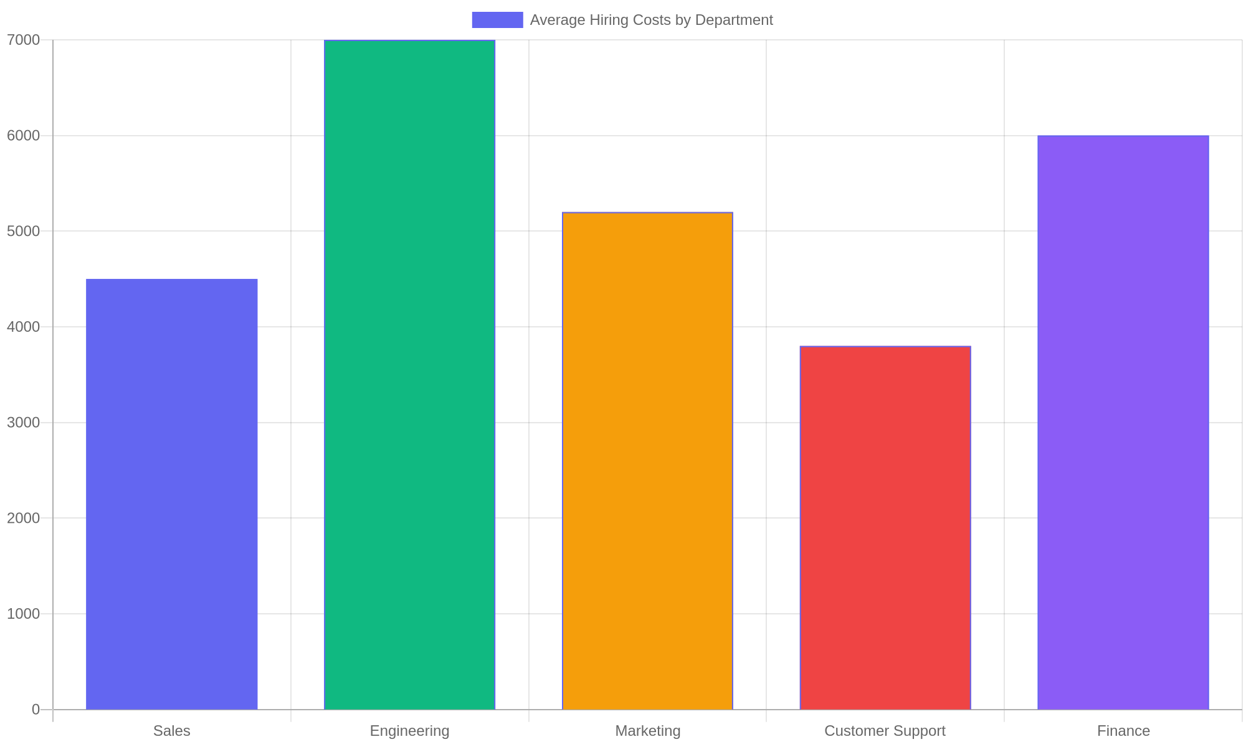
Average Hiring Costs by Department
Bar chart illustrating the average cost incurred to hire employees across various departments, highlighting differences in recruitment expenses.

Slide 19
Key Financial Indicators in HR Evaluation - Part 4
Employee Attrition Expenses
Attrition expenses encompass the costs related to employee turnover, including recruitment, training, lost productivity, and potential impacts on team morale.
• Direct costs include exit processing, hiring, and onboarding replacements.
• Indirect costs cover lost knowledge, decreased morale, and reduced team efficiency.
• High attrition rates can significantly affect organizational profitability.
• Tracking attrition expenses aids in identifying problematic areas.
• Reducing turnover through engagement and retention strategies lowers financial burdens.
Attrition-related costs extend beyond recruitment expenses, affecting productivity and culture. Measuring these expenses helps HR prioritize retention efforts and minimize financial losses caused by turnover.
Understanding the financial impact of employee attrition is crucial for managing workforce stability. By quantifying both direct and indirect costs, HR professionals can develop targeted retention plans that protect organizational resources and improve employee satisfaction.

Slide 20
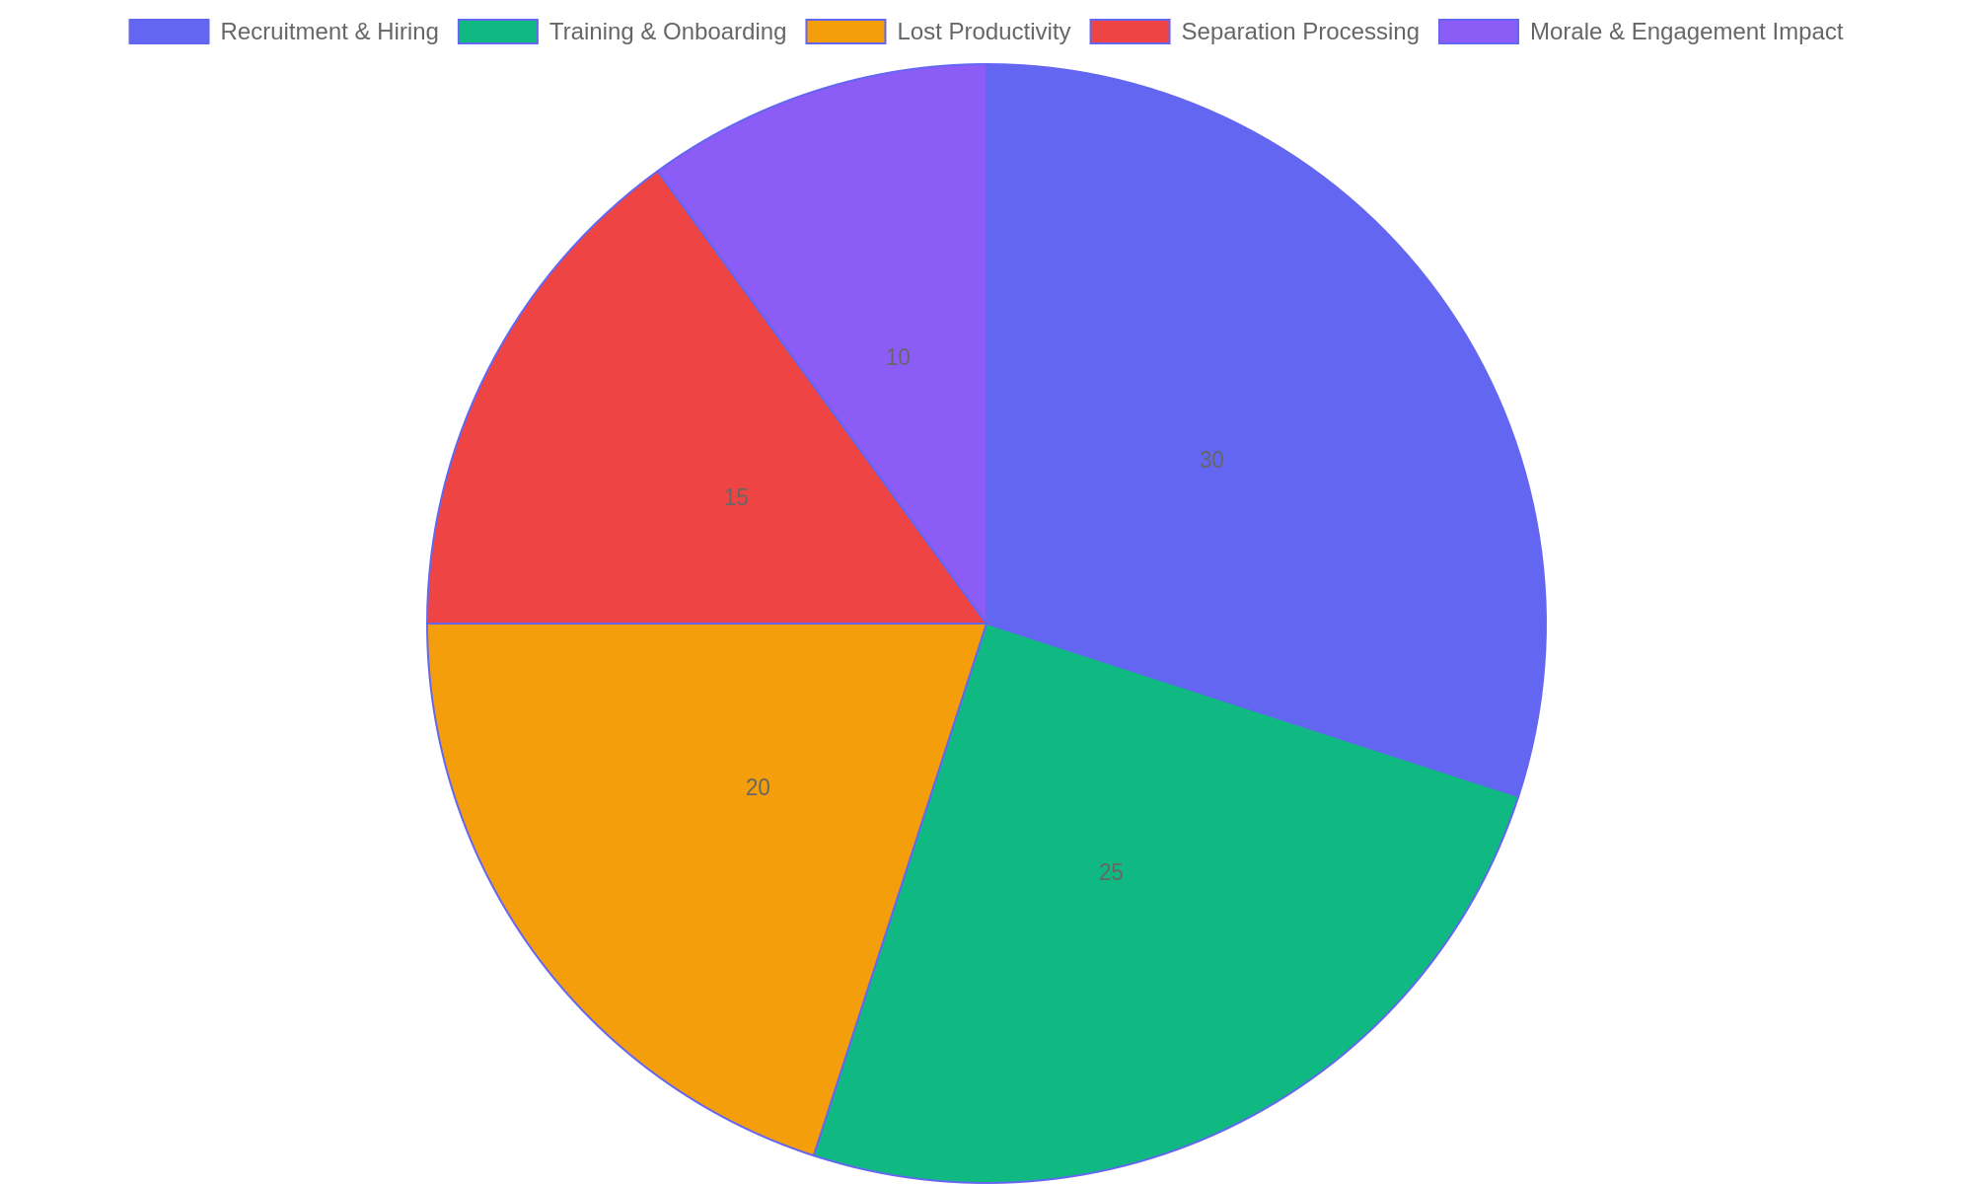
Breakdown of Employee Attrition Costs
Pie chart showing the proportional distribution of various cost components contributing to overall employee attrition expenses.

Slide 21
Designing Effective Benefits Programs - Part 1
Balancing Financial Constraints and Employee Needs
Creating benefits programs requires a careful balance between available financial resources and what employees value most. HR professionals must understand budget limits while designing offerings that foster satisfaction and loyalty.
• Analyze organizational budget to determine benefits affordability
• Identify employee preferences through surveys and feedback
• Prioritize benefits that deliver high perceived value
• Integrate benefits with total rewards strategy for cohesion
• Continuously review and adjust offerings to maintain relevance
A well-designed benefits program considers both financial constraints and employee desires. By prioritizing impactful benefits within budget, HR ensures programs enhance satisfaction and promote retention.
Effective benefits programs are crafted by aligning budget realities with employee expectations. HR professionals must evaluate costs and preferences, ensuring that benefits contribute positively to engagement without exceeding financial limits. This balance supports long-term workforce stability and organizational success.

Slide 22
Designing Effective Benefits Programs - Part 2
Key Financial Considerations in Benefits Design
Understanding the financial implications of benefits choices enables HR to optimize program effectiveness. Costs must be forecasted accurately, and potential savings opportunities identified to sustain offerings.
• Calculate direct and indirect costs of each benefit option
• Evaluate tax implications and compliance requirements
• Consider long-term liabilities such as pensions or retiree health
• Explore vendor negotiations to lower expenses
• Monitor utilization rates to identify cost drivers
Thorough financial analysis, including cost estimation and regulatory review, helps HR craft benefits packages that are both affordable and attractive to employees.
Financial insight is crucial when designing benefits programs. HR must assess all associated costs and regulatory factors, seek cost efficiencies, and track usage patterns to create sustainable and compliant benefits that support organizational goals.

Slide 23

Typical Benefits Budget Allocation
Distribution of a representative organization's benefits budget across key categories.

Slide 24
Designing Effective Benefits Programs - Part 4
Enhancing Employee Satisfaction Through Benefits
Benefits are a key driver of employee morale and loyalty. Thoughtful program design can improve workplace culture and reduce turnover by addressing diverse workforce needs.
• Offer flexible benefits to accommodate different life stages
• Include wellness initiatives to support overall well-being
• Communicate clearly about benefits value and usage
• Solicit ongoing employee feedback for continuous improvement
• Link benefits to performance and recognition where appropriate
Tailored and well-communicated benefits contribute to higher employee satisfaction, enhancing retention and workplace harmony.
Employee satisfaction increases when benefits align with personal needs and are clearly communicated. Flexible, inclusive programs that evolve with workforce feedback foster engagement and demonstrate organizational commitment.

Slide 25
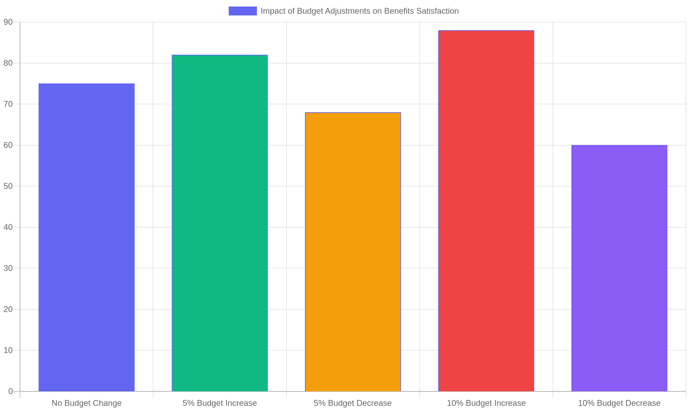
Impact of Budget Adjustments on Benefits Satisfaction
Effect of varying budget levels on employee satisfaction scores with benefits programs.

Slide 26
Aligning Financial Insights with HR Strategies - Part 1
Integrating Financial Awareness into HR
Understanding financial data empowers HR professionals to make informed decisions that align workforce management with organizational fiscal goals.
• Use financial metrics to guide talent acquisition and retention.
• Align compensation strategies with budgetary constraints and market trends.
• Incorporate cost-benefit analysis in employee development programs.
• Leverage payroll data to optimize workforce planning.
• Collaborate with finance teams to forecast HR-related expenses.
HR professionals who understand financial indicators can better plan recruitment, benefits, and training programs. This alignment helps control costs and drive strategic growth.
Incorporating financial insights into HR processes ensures decisions support overall business sustainability. By aligning HR initiatives with financial realities, organizations can optimize resource allocation, enhance employee value, and maintain competitive advantage while fostering a financially responsible culture.

Slide 27
Aligning Financial Insights with HR Strategies - Part 2
Promoting Financial Competence Among Employees
Encouraging financial literacy within the workforce builds confidence and engagement, contributing to a culture that supports organizational success.
• Implement financial education workshops for employees.
• Share transparent financial performance updates regularly.
• Encourage budgeting skills through practical tools and resources.
• Link financial understanding to personal and professional growth.
• Recognize and reward financially responsible behaviors.
By fostering financial literacy, HR helps employees understand their role in the company’s financial health, enhancing motivation and accountability.
Developing financial competence among employees not only improves individual decision-making but also strengthens commitment to organizational goals. A financially savvy workforce is better equipped to contribute to cost-saving initiatives and long-term sustainability.

Slide 28
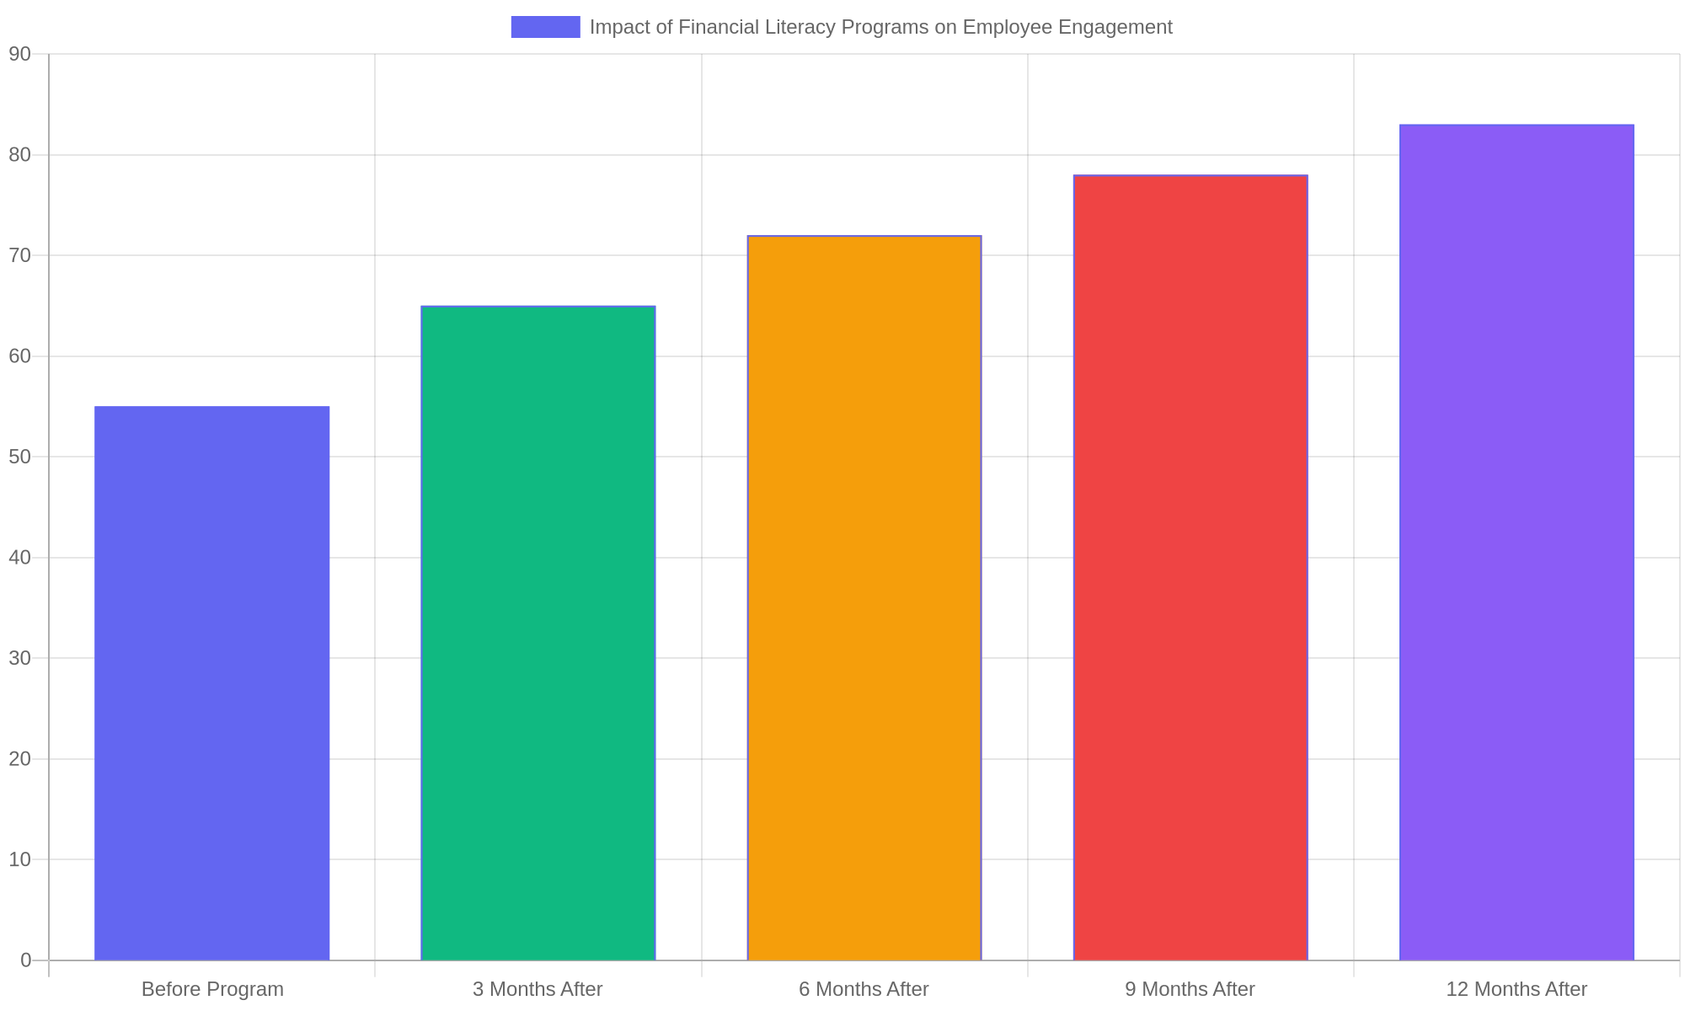
Impact of Financial Literacy Programs on Employee Engagement
Bar chart illustrating the steady increase in employee engagement scores following implementation of financial literacy initiatives.

Slide 29
Aligning Financial Insights with HR Strategies - Part 4
Strategies for Merging Financial and HR Goals
Effective integration of finance and HR requires clear communication, shared objectives, and collaborative planning.
• Establish cross-functional teams including HR and finance professionals.
• Define shared KPIs linking financial outcomes to HR activities.
• Use data analytics to monitor workforce cost efficiency.
• Align performance management systems with financial targets.
• Regularly review HR budgets in the context of organizational financial health.
Joint planning and transparent communication between HR and finance promote alignment, enabling workforce strategies that support financial goals and optimize resource use.
Bridging finance and HR functions enhances strategic alignment and operational efficiency. Collaborative frameworks and shared metrics ensure that workforce initiatives directly contribute to financial objectives, enabling sustainable growth and improved organizational performance.

Slide 30
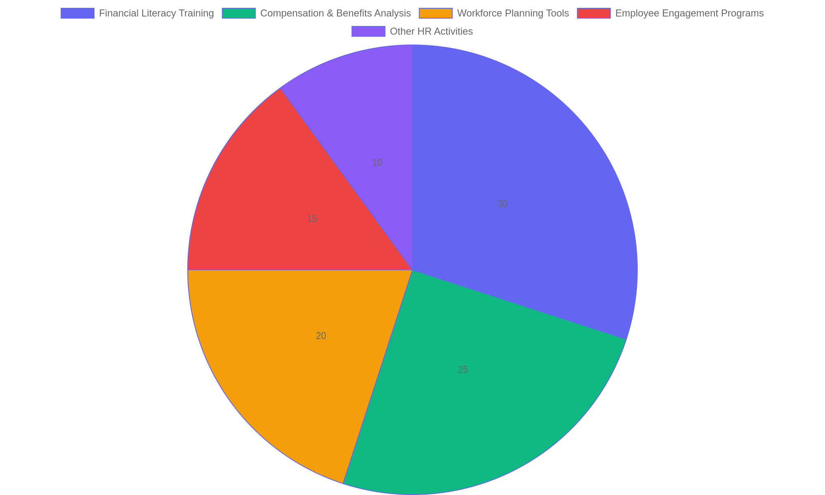
Allocation of HR Budget Towards Financial Competency Initiatives
Pie chart showing how HR budgets are distributed to support financial competence and strategic alignment.

