Slide 1
Introduction to Ethical Principles in Finance - Part 1
Core Ethical Foundations
Ethical principles in finance establish the foundation for responsible conduct and decision-making. They guide professionals to act with honesty, fairness, and accountability, ensuring that financial services support trust and long-term relationships.
• Integrity demands consistent honesty and adherence to moral values.
• Transparency involves clear, open communication with clients and stakeholders.
• Fairness ensures equitable treatment and impartial decisions.
• Accountability requires owning outcomes and accepting responsibility.
• Respect for clients’ interests fosters trust and loyalty.
Ethical behavior in finance revolves around acting honestly, communicating openly, treating all parties fairly, accepting responsibility for actions, and prioritizing client interests to build trust and credibility.
Understanding ethical principles is crucial for financial professionals to maintain credibility and client confidence. Emphasizing integrity, transparency, fairness, accountability, and respect helps organizations build sustainable relationships and uphold industry standards. These principles not only protect clients but also enhance the reputation and stability of financial institutions.

Slide 2
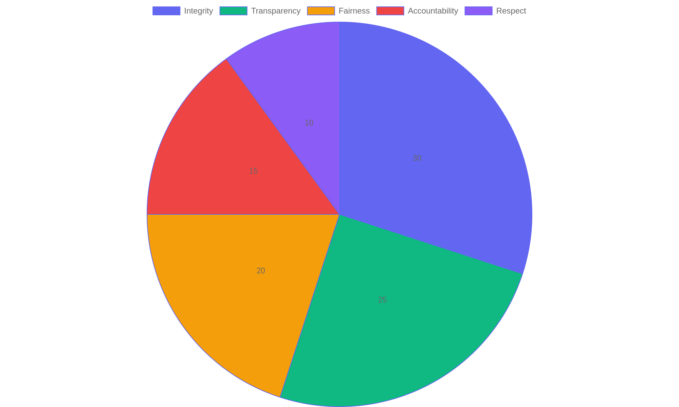
Distribution of Ethical Priorities in Finance
Proportional emphasis placed on key ethical principles by finance professionals.

Slide 3
Introduction to Ethical Principles in Finance - Part 3
Impact on Client Trust and Credibility
Ethical principles directly influence how clients perceive financial institutions. Upholding these standards strengthens trust, reduces risks of misconduct, and enhances the organization's reputation in a competitive market.
• Trust is built when clients see consistent ethical behavior.
• Transparency reduces misunderstandings and promotes clarity.
• Fairness prevents conflicts and promotes equitable outcomes.
• Accountability reassures clients that mistakes will be addressed.
• Respect fosters long-term loyalty and positive relationships.
Ethical conduct enhances client trust by ensuring fairness, openness, responsibility, and respect, all of which contribute to a financial institution’s positive standing and long-term success.
Client trust and organizational credibility in finance depend heavily on ethical conduct. When financial professionals consistently apply ethical principles, clients feel confident in their services. This confidence translates into stronger client retention, fewer legal issues, and a competitive advantage for the institution.

Slide 4
Understanding Compliance Regulations - Part 1
Key Regulatory Frameworks
Financial institutions operate under strict legal frameworks designed to maintain market integrity and protect consumers. Several major laws and regulatory bodies set the standards for compliance, shaping daily operations and risk management.
• The Securities Exchange Act governs trading practices and market transparency.
• The Dodd-Frank Act enhances oversight of financial institutions to reduce systemic risk.
• The Financial Industry Regulatory Authority (FINRA) oversees brokerage firms and exchange markets.
• The Office of the Comptroller of the Currency (OCC) supervises national banks and federal savings associations.
• The General Data Protection Regulation (GDPR) enforces strict data privacy standards affecting financial data handling.
Understanding the primary laws and regulatory agencies is essential for compliance. These frameworks dictate operational standards, risk controls, and data handling protocols that financial firms must follow to maintain lawful and ethical business practices.
Compliance regulations in financial services are established through a variety of laws and supervisory bodies. These frameworks ensure transparency, protect consumers, and reduce systemic risks. Institutions must navigate complex requirements from securities laws to data privacy mandates, all of which demand rigorous adherence to avoid legal penalties and reputational damage.

Slide 5
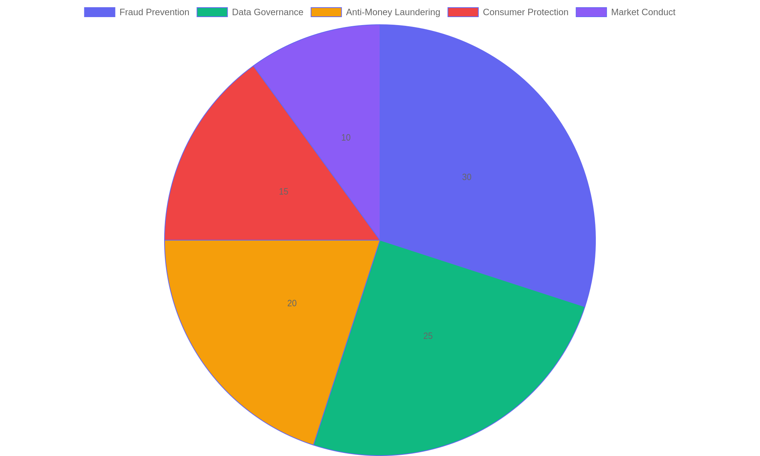
Distribution of Compliance Focus Areas in Financial Services
This pie chart illustrates the proportional emphasis placed on various compliance areas within financial institutions, highlighting fraud prevention and data governance as primary concerns.

Slide 6
Understanding Compliance Regulations - Part 3
Compliance Responsibilities and Risks
Compliance officers and financial professionals must actively manage risks by adhering to regulatory standards. Failure to comply can lead to severe penalties, including fines, legal action, and damage to reputation.
• Implementing robust anti-fraud measures to detect and prevent financial crimes.
• Ensuring accurate and secure management of sensitive client data.
• Regularly updating policies to align with evolving regulatory requirements.
• Conducting ongoing employee training on compliance and ethical standards.
• Monitoring and reporting suspicious activities to regulatory authorities promptly.
Compliance duties encompass fraud prevention, data protection, policy updates, staff training, and timely reporting. These actions help reduce operational risks and ensure adherence to legal standards, safeguarding both the institution and its clients.
Effective compliance management involves proactive risk mitigation, continuous education, and vigilant monitoring. Organizations that fail to uphold these responsibilities may face regulatory sanctions, financial losses, and erosion of client trust, emphasizing the critical role of compliance in sustaining business integrity.

Slide 7
Creating a Culture of Ethical Compliance - Part 1
Foundations of Ethical Culture
Building an organizational culture that champions ethical compliance involves intentional leadership, clear policies, and continuous education. This slide explores essential components that help embed ethical values into everyday business practices.
• Leadership must model ethical behavior consistently to set standards.
• Develop transparent policies that define expected conduct clearly.
• Establish open communication channels for ethical concerns.
• Incorporate ethics training tailored to specific job roles.
• Encourage accountability at all organizational levels.
Effective ethical cultures rest on leadership commitment, clear guidelines, and ongoing education. These elements work together to make ethical compliance a shared responsibility embedded within organizational behavior.
Creating a culture that values ethical compliance requires leaders to exemplify integrity and communicate expectations clearly. Organizations must implement well-defined policies and foster an environment where employees are educated and empowered to act ethically. Continuous dialogue and accountability reinforce these principles, ensuring ethical standards become integral to daily operations.

Slide 8

Key Drivers of Ethical Compliance Culture
Distribution of critical factors contributing to a strong ethical compliance culture within organizations.

Slide 9
Monitoring and Advancing Compliance Efforts - Part 1
Continuous Compliance Evaluation
Sustained success in ethics and compliance requires regular review and refinement of policies and practices. This slide explores key methods for assessing compliance effectiveness and the importance of adaptive strategies.
• Implement routine audits to identify gaps and risks.
• Utilize feedback from employees and stakeholders to improve processes.
• Establish clear, accessible reporting channels for compliance concerns.
• Leverage data analytics to monitor compliance trends and anomalies.
• Promote a culture of transparency and accountability throughout the organization.
Regular assessments and open communication channels enable organizations to identify risks and enhance compliance measures. Integrating data-driven insights with employee feedback supports adaptive strategies that uphold ethical standards.
Ongoing evaluation is essential to maintain robust compliance frameworks in financial services. By combining audits, stakeholder input, and data analysis, organizations can detect weaknesses early and respond effectively. Transparent reporting systems foster trust and support proactive management. Continuous improvement ensures that ethics programs remain relevant amid evolving regulatory and market environments.

Slide 10
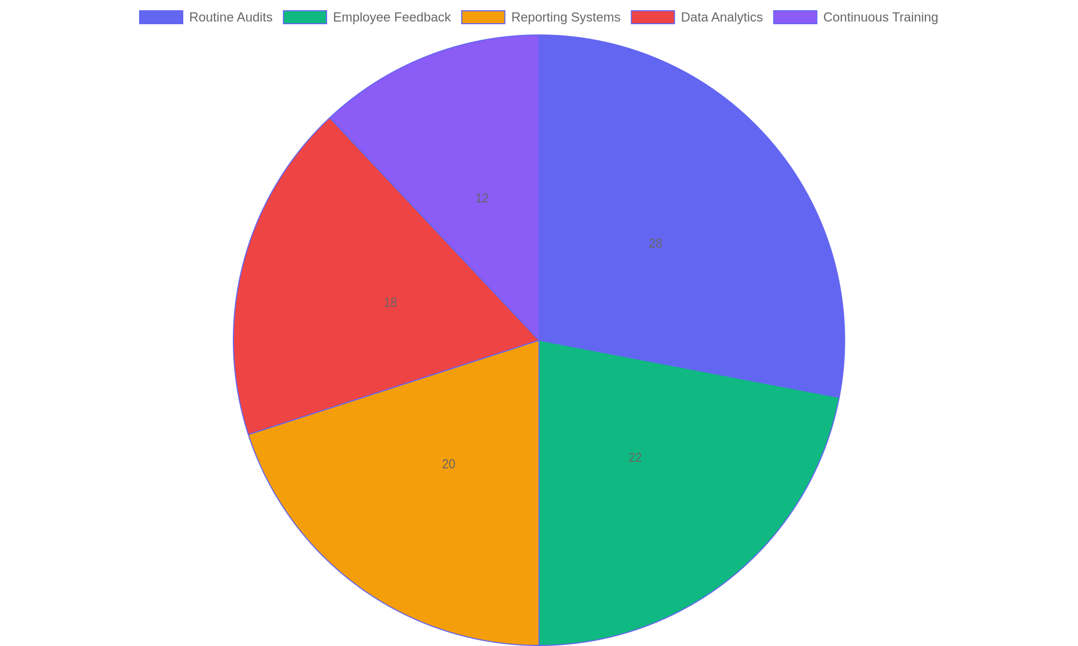
Components Contributing to Effective Compliance Monitoring
Distribution of key elements that strengthen ongoing compliance monitoring efforts in financial services.

