Slide 1
Basic Economic Concepts - Part 1
Core Principles of Economics
This slide introduces foundational ideas that shape economic thinking, focusing on scarcity, decision-making, and how incentives guide behavior at both individual and societal levels.
• Scarcity means limited resources versus unlimited wants.
• Choices arise because resources cannot satisfy all desires.
• Opportunity cost represents the next best alternative given up.
• Incentives motivate individuals and groups to act in certain ways.
• Economic behavior is influenced by how people respond to trade-offs.
Scarcity forces decision-making since resources are finite. Opportunity cost helps evaluate trade-offs, while incentives guide behavior by rewarding or penalizing actions. These ideas build the foundation for economic analysis and explain how resource allocation occurs in various contexts.
Understanding scarcity highlights why choices are necessary in economics. Every decision involves weighing alternatives, where opportunity cost plays a key role. Incentives act as triggers that encourage or discourage specific actions, shaping economic outcomes. These basic concepts together provide a framework for analyzing how individuals and societies allocate resources efficiently.

Slide 2
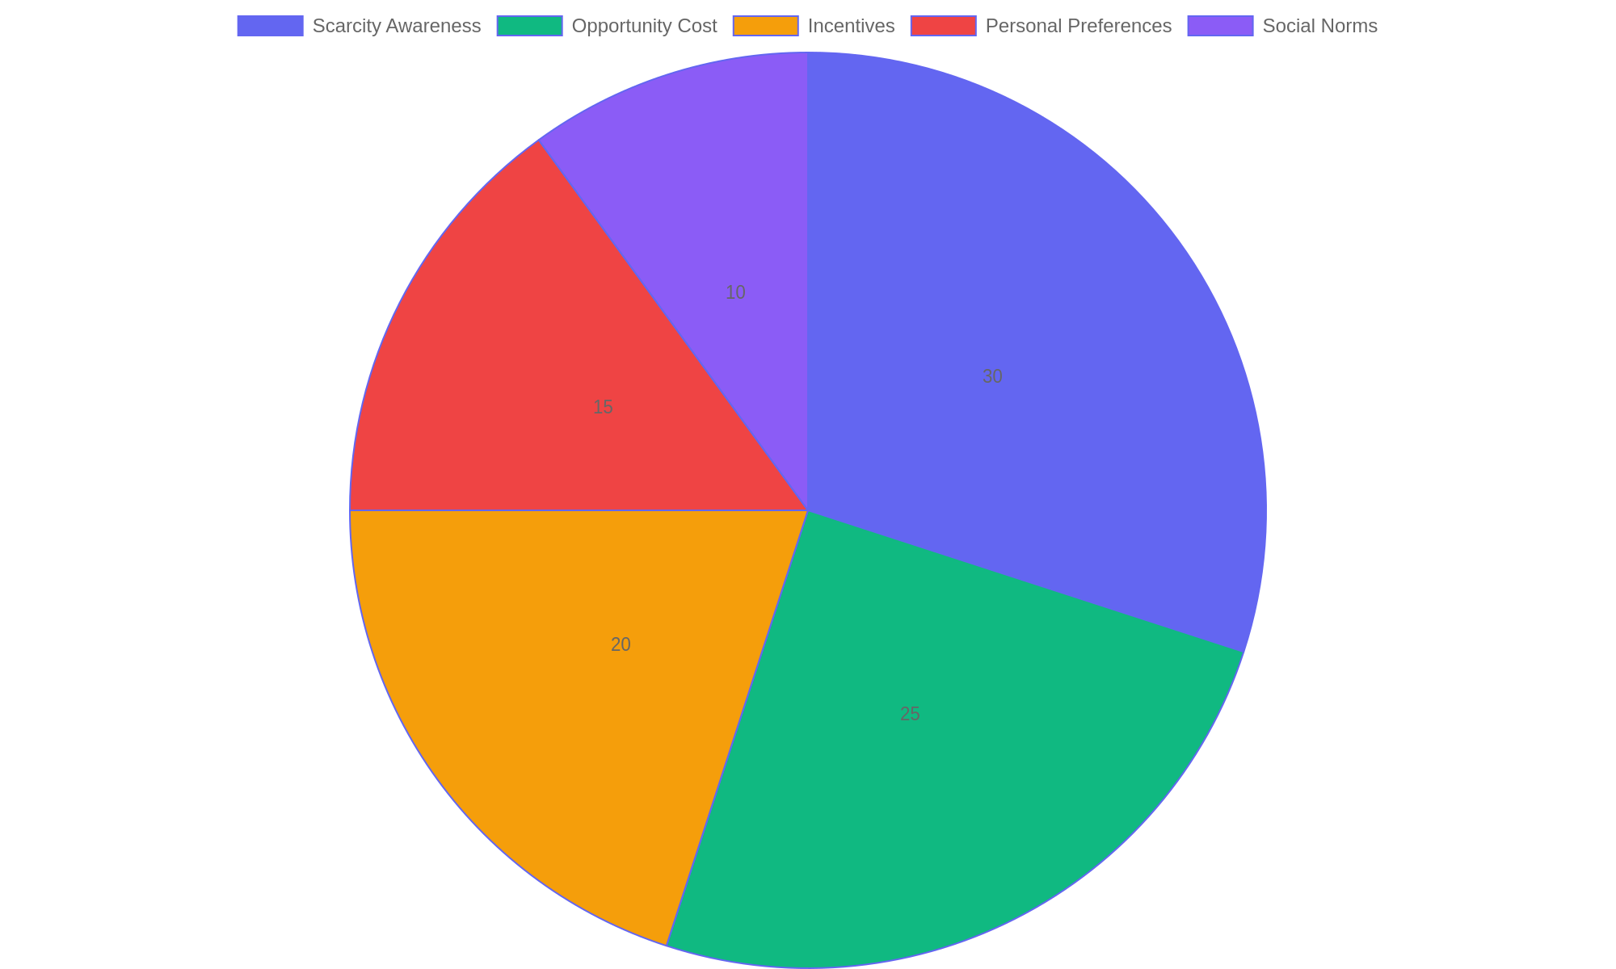
Factors Influencing Economic Choices
Distribution of key factors that shape how individuals and societies make economic decisions.

Slide 3
Understanding Market Mechanisms - Part 1
Types of Market Mechanisms
Market mechanisms determine how goods and services are allocated based on the interaction between buyers and sellers. Different market structures influence pricing, competition, and consumer choice in unique ways.
• Competitive markets feature many sellers and buyers, promoting price-driven efficiency.
• Monopolies exist when a single firm dominates, often controlling prices and supply.
• Oligopolies consist of a few large firms that influence market conditions collectively.
• Each structure affects consumer behavior differently through availability and pricing.
• Market efficiency varies, with competition generally enhancing resource allocation.
Competitive, monopoly, and oligopoly markets differ in the number of participants and control over prices. These differences influence how efficiently resources are allocated and how consumers react to pricing changes.
Market mechanisms shape economic outcomes by defining how resources and products are distributed. Competitive markets encourage innovation and fair pricing, while monopolies can restrict choices and raise prices. Oligopolies balance between competition and cooperation, impacting market dynamics. Understanding these types helps analyze real-world pricing strategies and consumer responses.

Slide 4
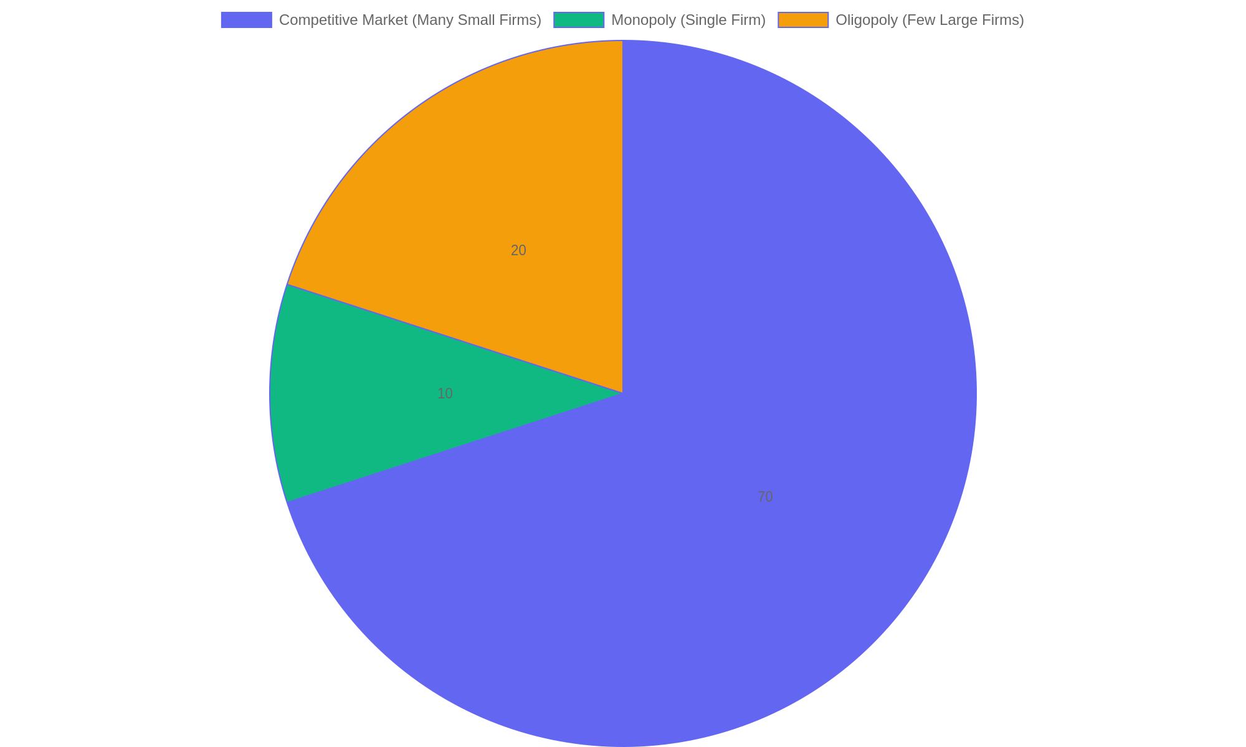
Market Share Distribution in Different Market Types
Illustrates typical market share concentration across different market structures, highlighting the dominance of firms in monopolies and oligopolies compared to competitive markets.

Slide 5
Economic Indicators and Their Implications
Key Economic Signals
Economic indicators provide measurable data reflecting the health and direction of an economy. They guide policymakers and analysts in understanding growth trends, inflation pressures, and labor market conditions, which are essential for crafting effective economic policies.
• Gross Domestic Product (GDP) measures the total value of goods and services produced, indicating overall economic activity.
• Inflation rates track changes in the general price level, affecting purchasing power and monetary policy decisions.
• Employment statistics reveal labor market strength, unemployment levels, and workforce participation.
• Interpreting these indicators helps governments balance growth objectives with inflation control and job creation.
• Economic strategies often adjust fiscal and monetary policies based on shifts in these key indicators.
By analyzing GDP, inflation, and employment figures, governments gain insights into economic momentum and challenges. This information supports the design of targeted interventions to stimulate growth, manage inflationary pressures, and improve labor market outcomes, promoting balanced economic stability.
Economic indicators such as GDP, inflation, and employment data serve as vital tools for assessing a nation’s economic condition. These measures influence government decisions aimed at maintaining stable growth, controlling inflation, and fostering employment. Understanding their interplay enables policymakers to respond proactively to economic fluctuations, ensuring sustainable development and financial stability.

Slide 6
International Economics and Trade Relations
Understanding Global Trade Dynamics
This segment delves into how countries interact economically on a global scale, highlighting patterns of trade, the multifaceted effects of globalization, and how governmental policies influence trade agreements and tariffs.
• Trade patterns emerge from comparative advantages and resource distribution.
• Globalization offers economic growth but can also increase inequality.
• Trade agreements aim to reduce barriers and promote cooperation.
• Tariffs protect domestic industries but may provoke trade disputes.
• Economic policies shape the balance between protectionism and free trade.
Trade relations are shaped by both market forces and regulatory frameworks. Policies on tariffs and agreements directly affect the flow of goods and services, impacting national economies and international partnerships. Understanding these interactions helps explain the complexities of global economic integration.
International economics examines how nations exchange goods, services, and capital, influenced by comparative advantages and policy decisions. Globalization fosters interconnected markets, offering benefits like efficiency and innovation, yet also challenges such as uneven development. Trade agreements and tariffs serve as tools for governments to regulate trade flows, balancing domestic interests with global cooperation to sustain economic growth and stability.

