Slide 1
Fundamentals of Cyber Risk - Part 1
Core Concepts of Cyber Risk
Understanding cyber risk begins with identifying the potential digital threats that could harm an organization’s information assets. This involves recognizing vulnerabilities, evaluating the likelihood of threats, and assessing possible impacts. Structured risk management helps organizations prioritize defenses and allocate resources effectively to minimize damage from cyber incidents.
• Cyber risk involves threats to digital information and systems.
• Risk identification focuses on spotting vulnerabilities and exposures.
• Threat assessment evaluates the probability and potential damage of attacks.
• Effective risk management requires systematic processes and frameworks.
• Prioritizing risks helps optimize security investments and response plans.
Cyber risk is the possibility of harm from digital threats exploiting system weaknesses. Identifying risks and assessing threats allow organizations to implement structured management strategies that reduce potential damage and improve overall cybersecurity posture.
Cyber risk fundamentals revolve around recognizing and understanding threats that target an organization’s digital environment. By identifying vulnerabilities and assessing threat likelihood and impact, organizations can adopt structured approaches to manage these risks. This process enables informed decision-making to protect assets, reduce exposure, and maintain operational resilience in the face of evolving cyber threats.

Slide 2
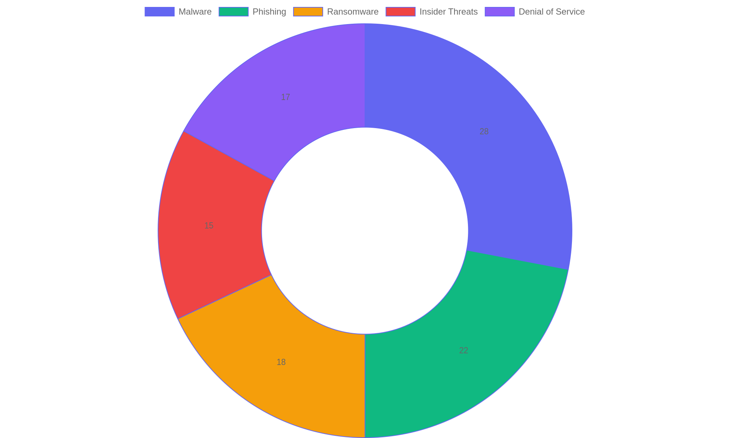
Common Categories of Cyber Threats
Distribution of prevalent cyber threats impacting organizations, highlighting the importance of recognizing various attack types for effective risk management.

Slide 3
Core Components of Cyber Risk Frameworks - Part 1
Fundamental Elements
A cyber risk framework is built on essential components that collectively create a structured approach to identifying, assessing, and mitigating cyber threats. Understanding each element's role is critical to developing a resilient security posture.
• Asset Inventory: Cataloging all digital and physical assets to understand what needs protection.
• Threat Analysis: Identifying potential sources of harm or attack vectors targeting assets.
• Vulnerability Assessment: Detecting weaknesses within systems that could be exploited.
• Risk Evaluation: Measuring the likelihood and impact of identified threats exploiting vulnerabilities.
• Risk Reduction Strategies: Implementing controls and safeguards to minimize exposure and potential damage.
A cyber risk framework systematically combines asset management, threat identification, vulnerability detection, risk evaluation, and mitigation. Each component informs the next, creating a continuous cycle of protection and improvement that strengthens cybersecurity resilience.
The core components of a cyber risk framework include a comprehensive asset inventory, detailed threat and vulnerability assessments, and practical risk reduction methods. These elements work in harmony to provide a clear picture of organizational risk and guide effective security measures. By integrating these parts, organizations can proactively manage cyber risks and enhance their defense mechanisms.

Slide 4
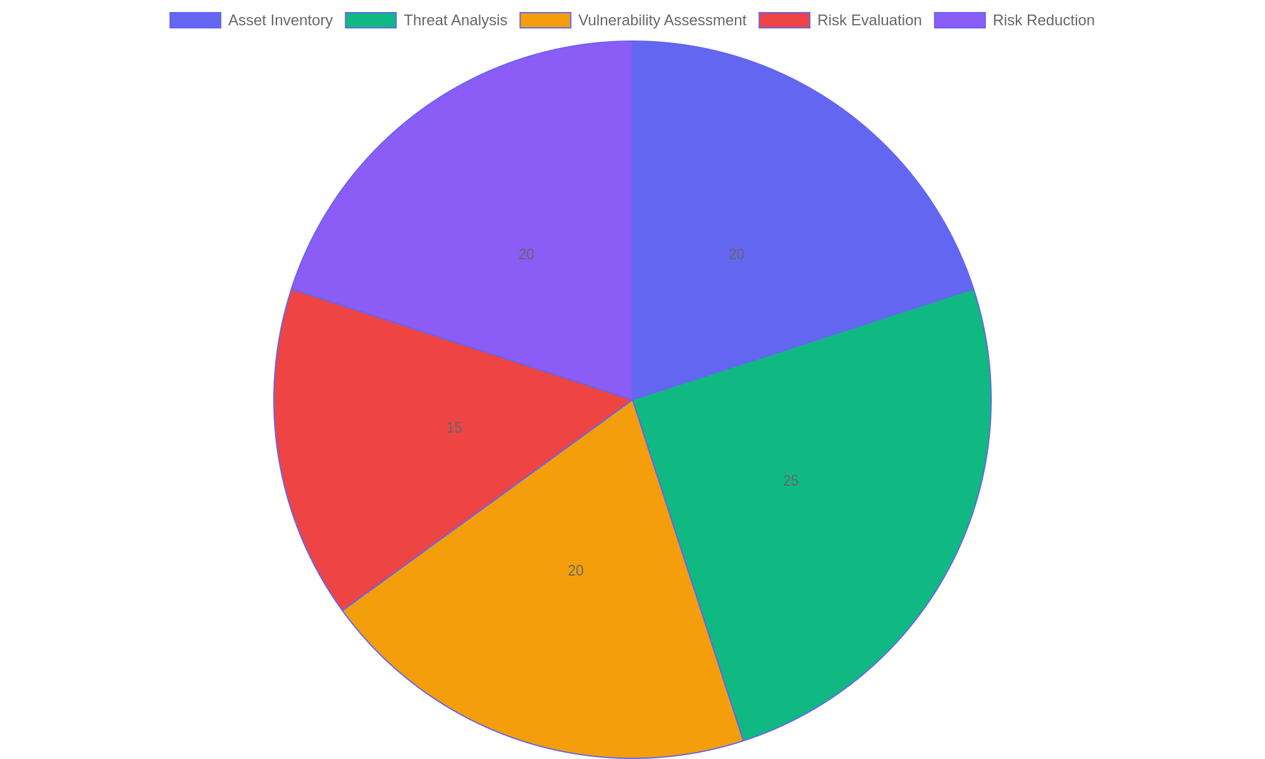
Proportionate Focus Areas in Cyber Risk Frameworks
Distribution of emphasis across fundamental elements in cyber risk frameworks, highlighting the balanced approach needed for effective risk management.

Slide 5
Practical Application of Cyber Risk Measures - Part 1
Implementing Cyber Risk Controls
Operationalizing a cyber risk framework requires clear policies, workforce training, incident protocols, and embedding risk management into daily activities to strengthen cybersecurity.
• Develop comprehensive cybersecurity policies aligned with organizational goals.
• Conduct regular workforce education to raise awareness and promote secure behaviors.
• Design and test incident response plans to ensure swift and effective reactions.
• Integrate risk assessment into routine operational processes for continuous monitoring.
• Establish accountability structures to maintain adherence and improve controls.
Effective application of cyber risk measures depends on clear policies, ongoing training, practical incident response plans, and embedding risk considerations into everyday operations to maintain a strong security environment.
Applying cyber risk measures involves creating tailored policies, educating employees consistently, and establishing clear incident response procedures. Embedding risk management into daily workflows ensures ongoing vigilance and adaptability. Together, these actions build a resilient cybersecurity posture that can anticipate, respond to, and recover from threats effectively within an organization.

Slide 6
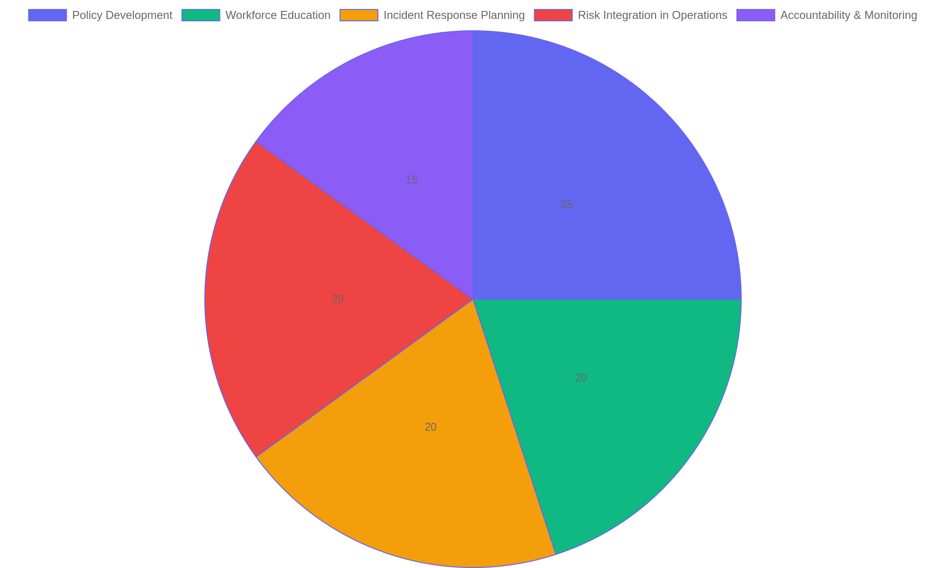
Focus Areas in Cyber Risk Operationalization
Distribution of organizational focus areas when implementing cyber risk frameworks to enhance security readiness.

Slide 7
Adapting and Reviewing Risk Frameworks
Continuous Improvement in Cyber Risk Management
Effective cyber risk frameworks require regular evaluation and adjustment to respond to evolving threats. This segment highlights methods for assessing framework performance, integrating emerging intelligence, and refining strategies to maintain resilient cybersecurity postures.
• Implement periodic assessments to identify framework gaps and weaknesses.
• Monitor emerging cyber threat trends and incorporate relevant insights promptly.
• Utilize feedback loops from incident responses to enhance risk controls.
• Adjust risk tolerance levels based on organizational changes and environment.
• Foster a culture of agility to rapidly update policies and procedures.
Regularly revisiting risk frameworks allows organizations to align defenses with current threat realities. By combining evaluation techniques with timely intelligence and adaptive strategies, cybersecurity programs can evolve proactively rather than reactively.
Sustaining a robust cyber risk framework demands ongoing review and adaptation. Organizations must systematically evaluate their frameworks, stay alert to new threat vectors, and continuously refine their response mechanisms. This dynamic approach ensures defenses remain effective despite the fast-changing cyber landscape, supporting long-term security resilience and risk mitigation.

