Slide 1
Foundations of Cultural Understanding - Part 1
Core Concepts of Workplace Culture
Understanding workplace culture begins with recognizing its fundamental elements and how they shape organizational behavior. Culture is the invisible framework that guides employee interactions, decision-making, and overall environment. It emerges from shared beliefs, values, traditions, and practices that evolve over time within an organization.
• Culture consists of shared values, beliefs, and behaviors unique to an organization.
• It influences communication styles, work ethics, and collaboration patterns.
• Culture develops through collective experiences and historical context.
• Leadership plays a pivotal role in establishing and nurturing culture.
• Individual values interact with group norms to shape daily workplace life.
Workplace culture is a complex blend of shared values and behaviors that develops over time. Leaders influence culture by modeling norms, while individuals contribute through their unique values, creating an evolving environment that impacts organizational effectiveness.
Workplace culture forms the foundation of how organizations operate and succeed. It is a dynamic system created by collective values and behaviors, influenced strongly by leadership and individual contributions. Recognizing these foundational elements helps participants appreciate the complexity and importance of culture in shaping organizational identity and performance.

Slide 2
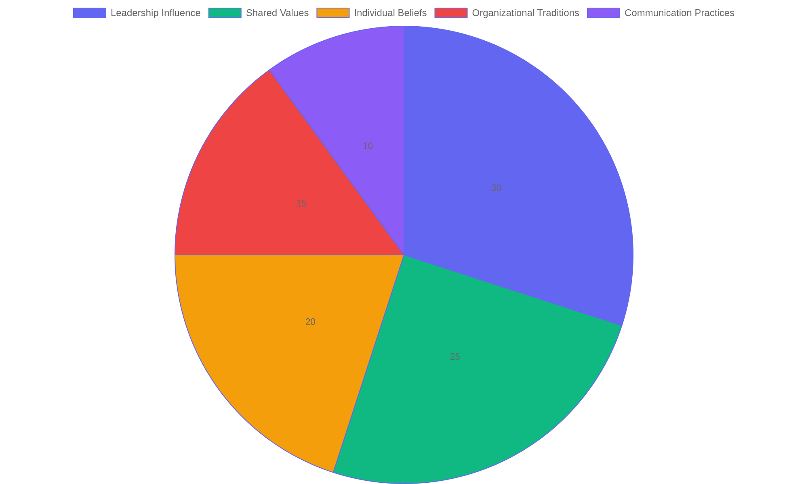
Key Components Influencing Workplace Culture
Distribution of primary factors that collectively shape workplace culture.

Slide 3
Evaluating Institutional Culture - Part 1
Approaches to Culture Assessment
Understanding the current organizational culture is essential for meaningful improvement. This involves gathering insights from employees, recognizing cultural patterns, and identifying areas that support or hinder the institution’s goals.
• Use surveys and questionnaires to gather anonymous employee feedback.
• Conduct focus groups to explore cultural perceptions in depth.
• Analyze internal communications for tone and messaging consistency.
• Identify cultural strengths that align with organizational values.
• Spot weaknesses that may create barriers to collaboration or innovation.
Effective culture evaluation blends data collection and analysis to reveal underlying beliefs and behaviors. Engaging employees through multiple channels ensures a well-rounded perspective, guiding informed decisions for cultural enhancement.
Evaluating institutional culture requires a systematic approach to uncover authentic employee experiences and organizational dynamics. By combining quantitative tools like surveys with qualitative methods such as focus groups, leaders can gain a comprehensive view of cultural health. Recognizing both strengths and gaps enables targeted strategies that foster a more cohesive and effective workplace environment.

Slide 4
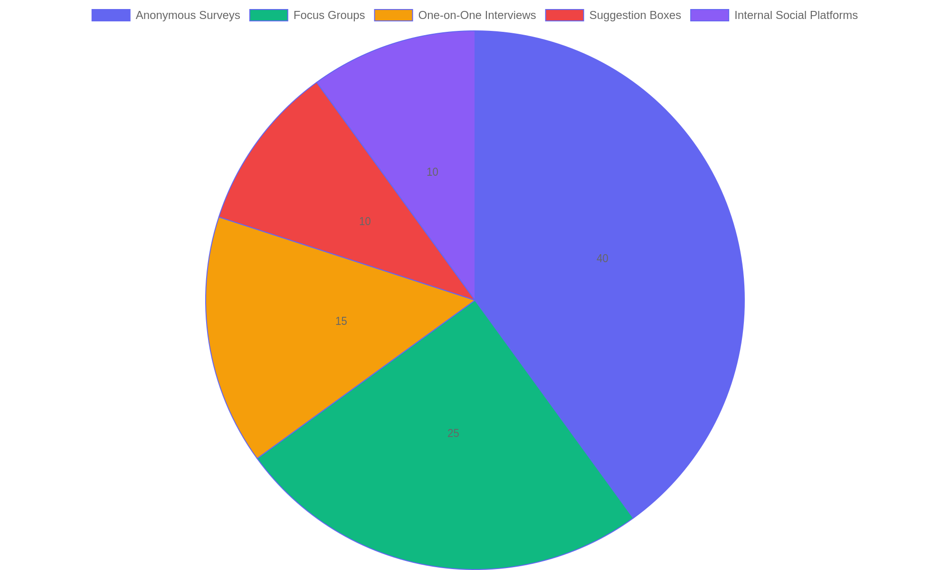
Employee Feedback Channels Used in Culture Assessment
Distribution of commonly used methods to collect employee input during culture evaluations.

Slide 5
Creating a Cultural Transformation Plan
Strategic Approach to Culture Change
Developing a cultural transformation plan involves deliberate steps to reshape organizational values and behaviors. This process requires clear change management tactics, transparent communication, and active participation from diverse stakeholders to ensure alignment and sustainable impact.
• Identify core cultural values to enhance or shift
• Apply structured change management frameworks
• Craft clear, consistent communication strategies
• Engage stakeholders across all organizational levels
• Analyze real-world examples to guide implementation
Creating a cultural transformation plan requires aligning goals with strategic actions, managing change effectively, communicating purpose clearly, and involving diverse participants. Learning from existing organizational successes helps tailor approaches to specific environments.
A cultural transformation plan centers on intentional design to evolve workplace culture. By integrating proven change management methods, maintaining open communication channels, and involving a broad range of stakeholders, organizations can foster meaningful and lasting cultural shifts. Examining successful cases provides practical insights that inform strategy and execution.

Slide 6
Maintaining Cultural Evolution
Sustaining Lasting Change
This segment focuses on strategies to embed and perpetuate cultural transformation within an organization. It highlights methods to reinforce desired behaviors, monitor progress effectively, and cultivate a culture of continuous improvement while addressing common obstacles to long-term commitment.
• Implement consistent reinforcement mechanisms to encourage target behaviors.
• Establish clear metrics to track cultural progress and identify areas for growth.
• Promote leadership involvement to model and support cultural values.
• Encourage open communication to adapt and refine cultural initiatives.
• Develop resilience strategies to overcome setbacks and maintain momentum.
Effective cultural maintenance blends regular reinforcement, transparent progress monitoring, and active leadership participation. Encouraging feedback and adapting strategies help overcome obstacles and sustain commitment, creating an environment where cultural growth becomes an integral, ongoing process.
Sustaining cultural evolution requires deliberate effort to reinforce new behaviors and maintain engagement over time. By tracking progress through measurable indicators and fostering leadership support, organizations can nurture a dynamic culture that embraces ongoing development. Addressing challenges proactively ensures that cultural changes endure and continue to evolve in alignment with organizational goals.

