Slide 1
Basics of Matter and Atomic Theory - Part 1
Fundamental Concepts of Matter and Atomic Structure
Matter is anything that occupies space and has mass. At its core, matter is composed of atoms, which are the smallest units retaining chemical properties. Atoms consist of a nucleus containing protons and neutrons, surrounded by electrons in defined regions. Understanding these subatomic particles and their arrangement forms the foundation of atomic theory.
• Matter is made up of atoms, the basic building blocks of all substances.
• Atoms contain protons (positive), neutrons (neutral), and electrons (negative).
• The nucleus houses protons and neutrons, while electrons orbit around it.
• Atomic number equals the number of protons and defines the element.
• Isotopes are atoms of the same element with differing neutron counts.
Atoms form matter and consist of three main particles: protons, neutrons, and electrons. The proton count defines the element's identity, while neutrons contribute to isotopes. Electrons orbit the nucleus, influencing chemical interactions. Grasping these basics is essential to atomic theory and the periodic classification of elements.
This segment introduces matter as composed of atoms, highlighting the internal structure of atoms including protons, neutrons, and electrons. It explains how atomic number determines an element and introduces isotopes, which are variations of atoms differing in neutron number. These fundamentals set the stage for understanding chemical behavior and the organization of elements in the periodic table.

Slide 2

Proportional Composition of Subatomic Particles in a Typical Atom
This pie chart illustrates the typical proportion of subatomic particles in an atom, emphasizing the relative presence of electrons compared to protons and neutrons within atomic structure.

Slide 3
Understanding Chemical Interactions - Part 1
Types of Chemical Bonds
Chemical bonds are forces that hold atoms together in compounds. The main types include ionic, covalent, and metallic bonds, each with distinct characteristics based on electron behavior and atomic interactions.
• Ionic bonds form through electron transfer between atoms, creating charged ions.
• Covalent bonds involve sharing electron pairs between atoms to achieve stability.
• Metallic bonds consist of a 'sea' of delocalized electrons surrounding metal ions.
• Bond type influences physical properties like melting point, conductivity, and solubility.
• Understanding bonds helps predict how substances combine and react chemically.
Ionic bonds result from electron exchange creating oppositely charged ions, covalent bonds share electrons to fill outer shells, and metallic bonds feature freely moving electrons that give metals their unique traits.
This slide introduces the fundamental categories of chemical bonds: ionic, covalent, and metallic. Each bond type arises from different electron arrangements and interactions between atoms. Recognizing these bonds is essential for grasping how elements combine to form compounds and how these compounds behave under various conditions.

Slide 4

Distribution of Bond Types in Common Compounds
This pie chart illustrates the prevalence of ionic, covalent, and metallic bonds in everyday chemical compounds, highlighting covalent bonds as the most common.

Slide 5
Chemical Reactions and Stoichiometric Principles - Part 1
Fundamentals of Chemical Reactions
Chemical reactions involve the transformation of reactants into products through the rearrangement of atoms. Understanding different reaction types and the principle that mass is conserved during these changes is crucial for predicting reaction outcomes.
• Chemical reactions are categorized into synthesis, decomposition, single replacement, double replacement, and combustion.
• The law of conservation of mass states that matter is neither created nor destroyed in a chemical reaction.
• Balancing chemical equations ensures the same number of atoms for each element on both sides of the reaction.
• Stoichiometry uses balanced equations to calculate the quantities of reactants and products involved.
• Accurate stoichiometric calculations help predict product yield and optimize reaction conditions.
Chemical reactions transform substances by rearranging atoms while preserving total mass. Balancing equations reflects this conservation. Stoichiometry uses these balanced equations to relate amounts of reactants and products, providing a quantitative framework for analyzing chemical processes.
This segment introduces the essential types of chemical reactions and highlights the fundamental law of conservation of mass. Participants will learn how to balance chemical equations methodically. The focus is on applying stoichiometric principles to quantify reactants and products accurately, enabling better analysis and prediction of reaction outcomes in practical scenarios.

Slide 6
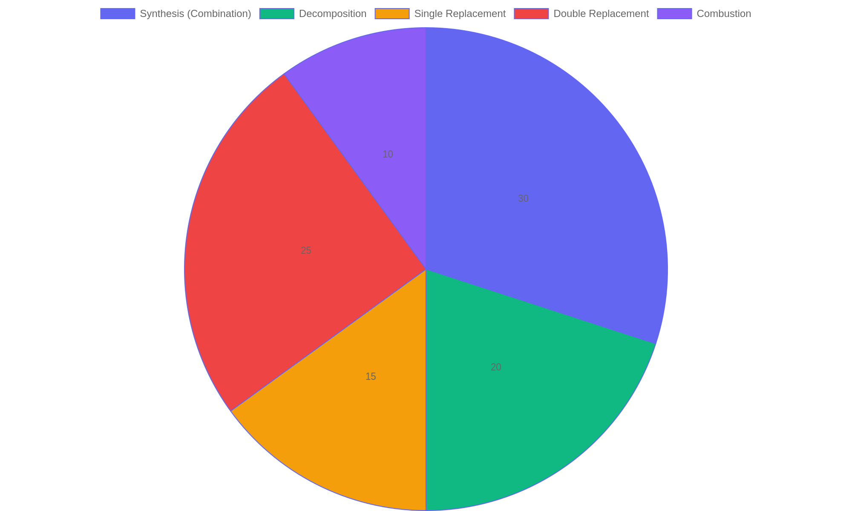
Distribution of Common Chemical Reaction Types
Proportional representation of various chemical reaction types commonly encountered in stoichiometric calculations.

Slide 7
Chemistry in Everyday Life
Significance and Applications
Chemistry plays a vital role in shaping modern life by driving innovations and solutions across multiple disciplines. From healthcare advancements to environmental protection and manufacturing efficiency, chemical principles underpin many essential processes that improve quality of life and address global challenges.
• Medicine: Chemistry enables development of pharmaceuticals and diagnostic tools.
• Environmental Science: It aids in pollution control and sustainable resource management.
• Industrial Processes: Chemistry improves production methods and material design.
• Energy Solutions: Innovations in chemical energy storage and conversion support renewable technologies.
• Everyday Products: Household items, food preservation, and personal care rely on chemical formulations.
The study of chemistry provides tools to solve practical problems in medicine, environment, and industry. It fosters development of new drugs, eco-friendly materials, and efficient processes that enhance daily life and contribute to sustainable progress.
Chemistry’s influence extends beyond the laboratory into daily experiences, impacting health, environment, and industry. By understanding chemical interactions, scientists create new medicines, develop cleaner technologies, and optimize manufacturing. This interconnectedness highlights chemistry’s essential role in addressing contemporary issues and advancing society’s well-being through continuous innovation.

