Slide 1
Fundamentals of Archaeological Sites - Part 1
Core Concepts
Archaeological sites serve as physical records of past human activity. Understanding their characteristics helps reveal the lifestyles, cultures, and environments of ancient communities. These sites vary widely, from settlements to burial grounds, each holding unique evidence that enriches our knowledge of history.
• Defined by location and preserved remains of past human activities
• Include artifacts, structures, and environmental evidence
• Provide insights into social, economic, and cultural practices
• Help reconstruct chronological sequences of ancient events
• Require careful excavation and documentation to preserve context
These sites represent tangible connections to past civilizations, containing material evidence that, when analyzed, reveals patterns of habitation, trade, and ritual. Their preservation and study are vital for reconstructing historical narratives accurately.
Archaeological sites are essential windows into history, capturing remnants of human existence across time. By studying these locations, researchers unlock details about ancient societies’ daily lives, beliefs, and interactions with their surroundings. Proper analysis of these sites supports a deeper understanding of human development and cultural diversity throughout history.

Slide 2
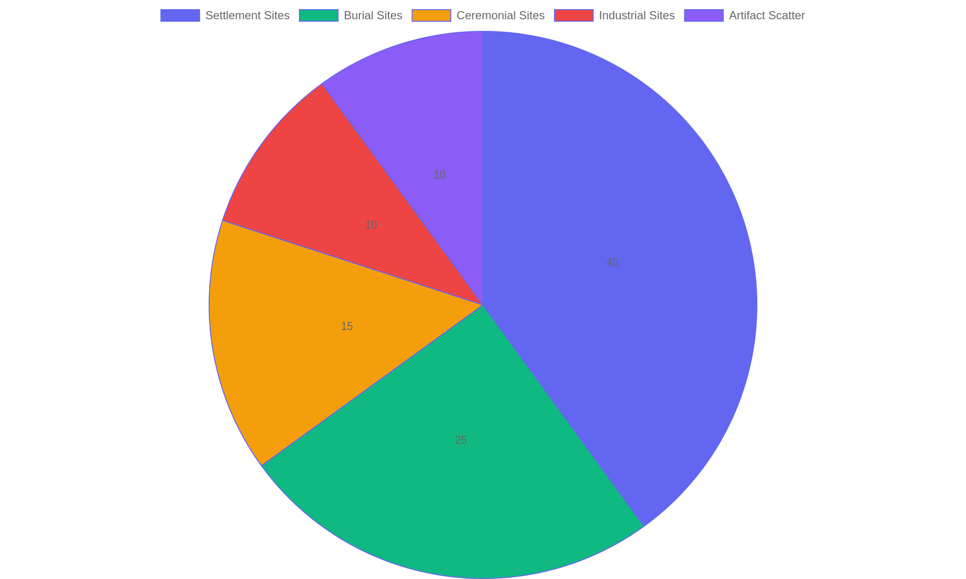
Types of Archaeological Sites and Their Prevalence
Distribution of common archaeological site types based on global excavations.

Slide 3
Excavation Methods and Practices - Part 1
Techniques and Tools in Archaeological Excavation
Excavation is a carefully planned process that uncovers artifacts and features beneath the surface. It requires a combination of specialized tools and systematic methods to preserve context and avoid damage. Understanding these techniques ensures that findings retain their informational value and contribute meaningfully to historical knowledge.
• Use of hand tools like trowels, brushes, and shovels for precise digging.
• Employing grid systems to divide the site into manageable units.
• Layer-by-layer removal to maintain chronological integrity.
• Screening soil to recover small artifacts and ecofacts.
• Detailed note-taking and mapping to document spatial relationships.
Excavation involves controlled digging using specific tools and grids to maintain order. Each soil layer is removed carefully to protect the sequence of occupation. Documentation through notes and maps is crucial for recording artifact locations and site features, preserving the integrity of the archaeological record.
Archaeological excavation relies on precise methods and appropriate tools to carefully expose buried materials. By working systematically through grid divisions and stratigraphic layers, archaeologists preserve the context of each find. This process is supported by thorough documentation, which is essential for interpreting the site’s history and ensuring that discoveries can be accurately analyzed and shared.

Slide 4
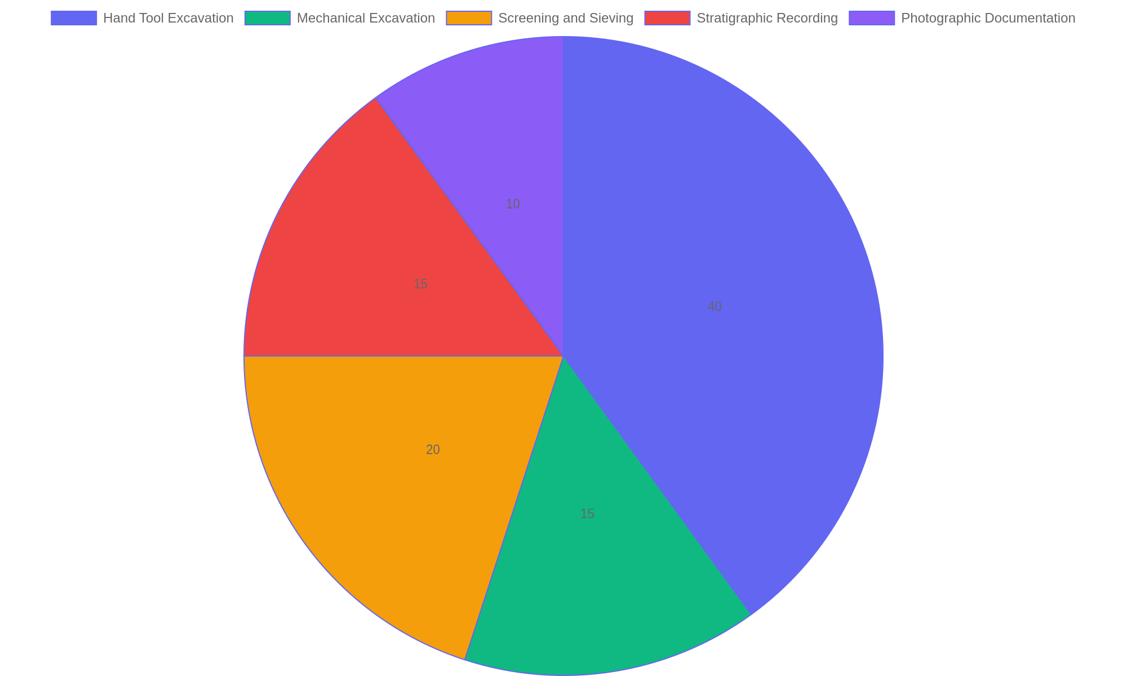
Distribution of Common Excavation Techniques
Percentage breakdown of primary excavation techniques used in archaeological digs, highlighting the predominance of manual methods and the importance of recording practices.

Slide 5
Interpreting Artifacts and Environmental Data - Part 1
Methods of Analysis
Understanding artifacts and environmental remains involves a combination of scientific techniques and contextual interpretation to reconstruct past human behaviors and environmental conditions.
• Typology categorizes artifacts by form and function to identify cultural patterns.
• Use-wear analysis reveals how tools and objects were utilized.
• Ecofact examination studies organic remains like pollen, seeds, and bones.
• Contextual analysis links artifacts to their spatial and stratigraphic positions.
• Radiocarbon dating and other scientific methods establish chronological frameworks.
Analytical techniques focus on both the physical attributes of artifacts and the ecological data surrounding them. This dual approach uncovers how objects were made, used, and discarded while situating them within broader environmental and temporal contexts.
Interpreting artifacts and environmental data requires integrating multiple analytical approaches. By examining physical characteristics, usage marks, and surrounding ecological evidence, researchers can piece together the lifestyles and environments of ancient communities. These methods help transform raw material remains into meaningful narratives about human history and environmental interactions.

Slide 6
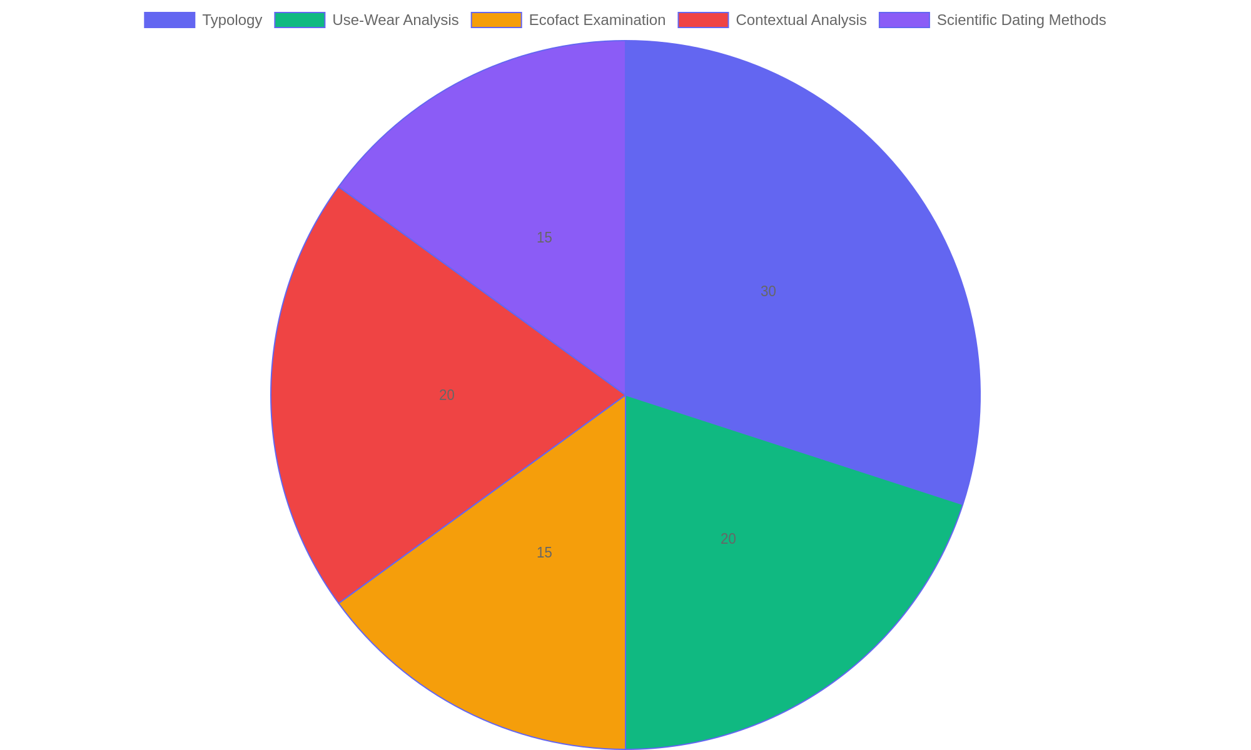
Distribution of Analytical Techniques in Archaeological Interpretation
Proportional use of various methods to interpret artifacts and environmental data in archaeological research.

Slide 7
Understanding Cultural Narratives Through Archaeology
Connecting Past and Present
Archaeology uncovers stories embedded in artifacts and sites, revealing how ancient peoples lived, believed, and interacted. These discoveries allow us to weave together cultural narratives that enrich our understanding of human history beyond written records.
• Artifacts serve as tangible links to past cultures and traditions.
• Excavations reveal social structures and daily practices of ancient communities.
• Cultural heritage shapes the interpretation of archaeological data.
• Narratives emerge by integrating scientific findings with oral histories.
• Archaeology fosters respect for diverse human experiences across time.
By examining artifacts and site contexts, archaeology reconstructs cultural narratives that deepen our appreciation of human history. These narratives combine empirical data with cultural insights, providing a richer, more nuanced understanding of past societies.
This segment emphasizes how archaeological research enhances our grasp of cultural stories by interpreting material remains within their broader heritage context. It highlights the role of archaeology in bridging scientific inquiry and human experience, allowing us to appreciate the layered narratives that define civilizations and their legacies.

